Slide 1
Nuts and Bolts of Supervision:
P-LPC to LPC Candidate Application
Notes:
RS

Slide 2
Supervised Experience requirements for the LPC
LPC requirements (Beginning July 1, 2018)
  3,000 post-masters
  1,200 direct services
  100 supervision
Notes:
KS/LE
Applicants after July 1, 2018 will not longer be able to count internship and practicum hours

Slide 3
Supervision Contract Requirements
P-LPCs must report supervised hours using the online log portal provided through the LPC Board’s website.
Supervised Experience must be entered in the online reporting log weekly and LPC-S reviews/edits/approves.
Notes:
KS/LE

Slide 4
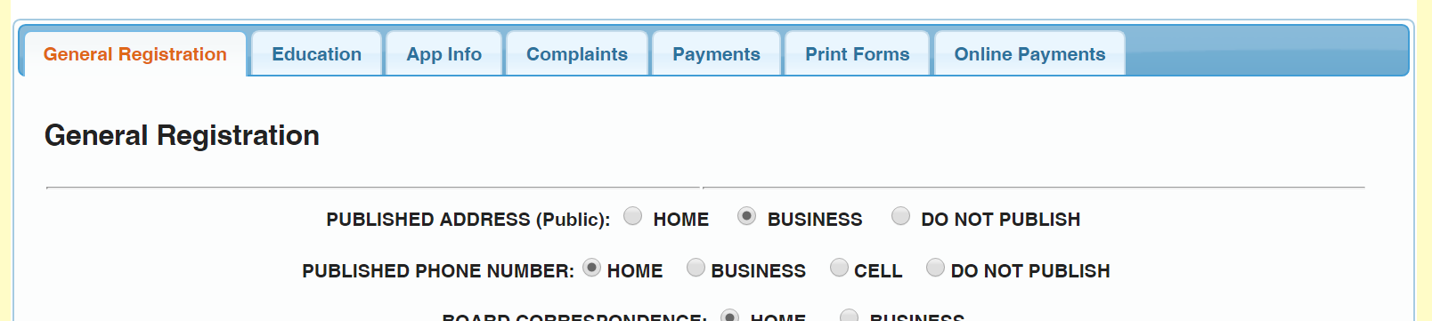
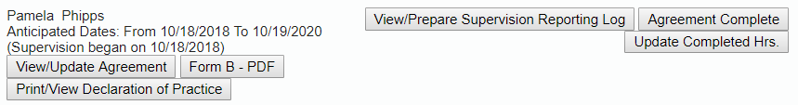
Documenting Supervised Experience

Slide 5
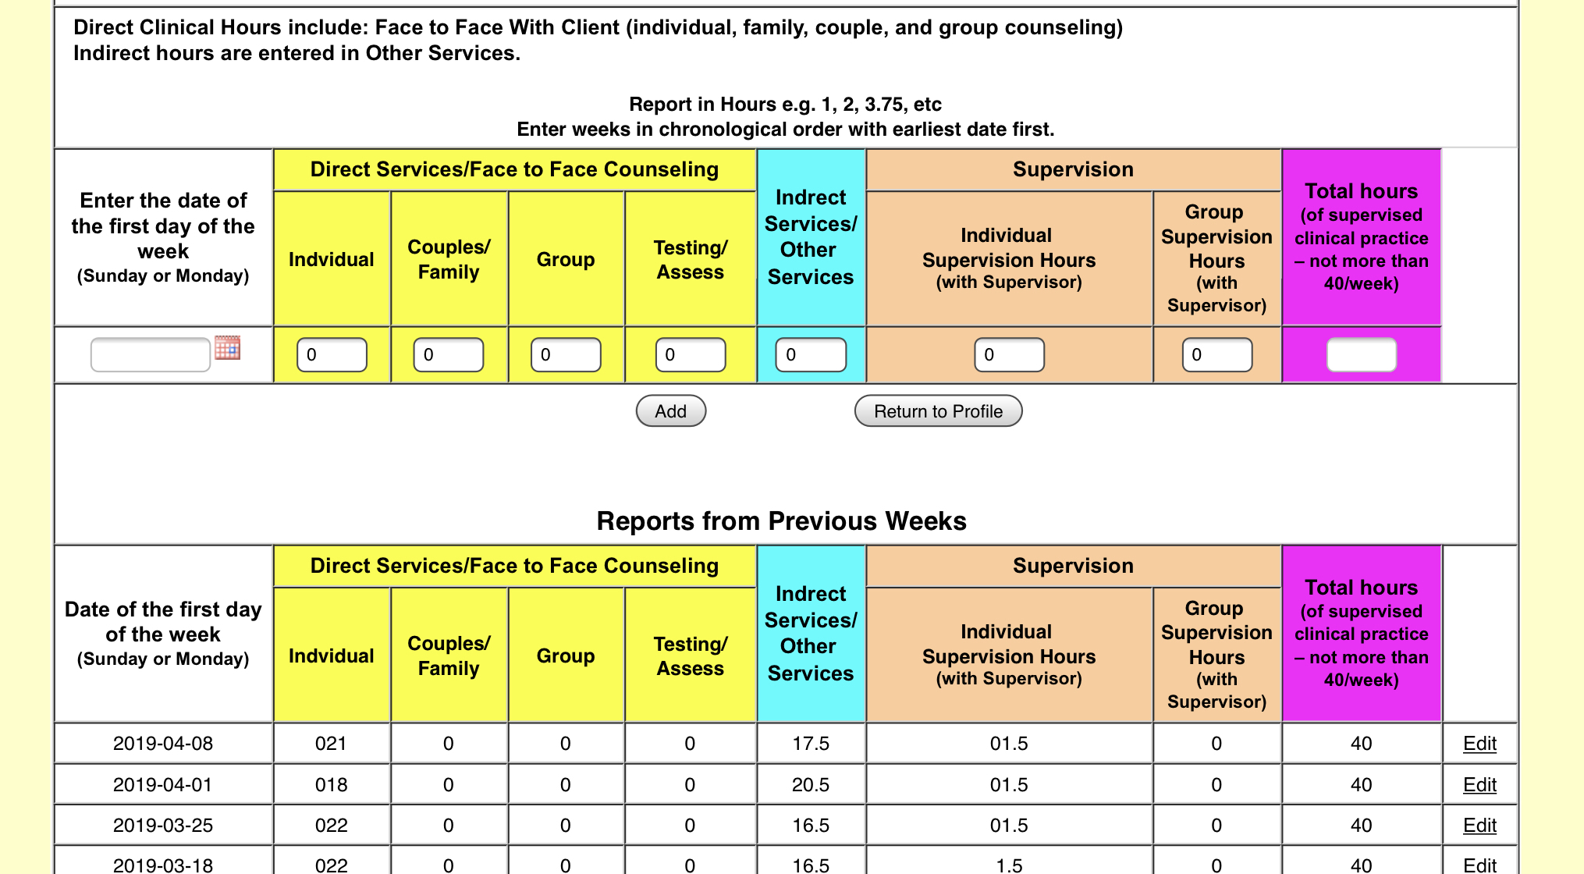
Documenting Supervised Experience
Complete during supervision
OR
Verify

Slide 6
Supervision Documentation
Form B is prepared by LPC-S and submitted electronically for the Board to review
Notes:
KS/LE
Applicants after July 1, 2018 will not longer be able to count internship and practicum hours

Slide 7
General Registration Tab

Slide 8
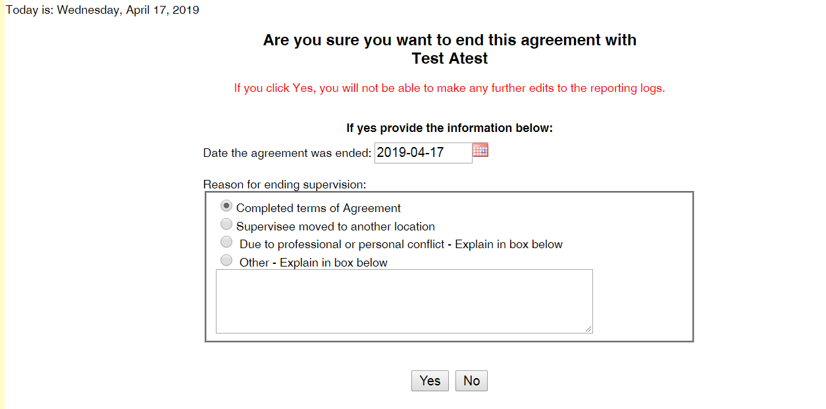

Slide 9
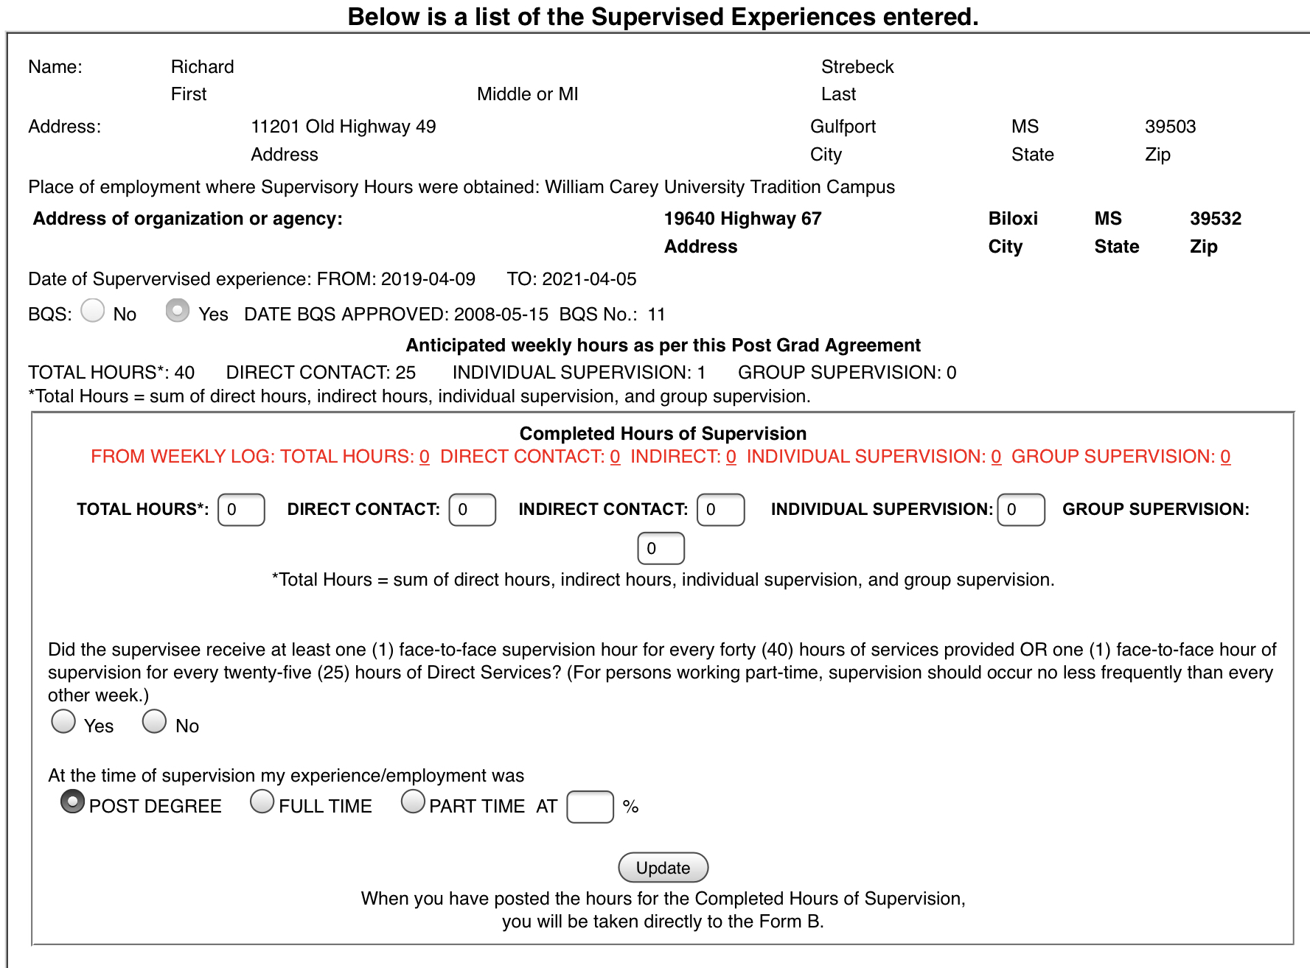
Verify/enter hours
Click update
Notes:
Hours entered into the weekly online logs are automatically populated in red text. When complete with supervision P-LPC or LPC-S will verify the hours by entering the totals in the boxes by clicking on the “update completed hours” button.

Slide 10
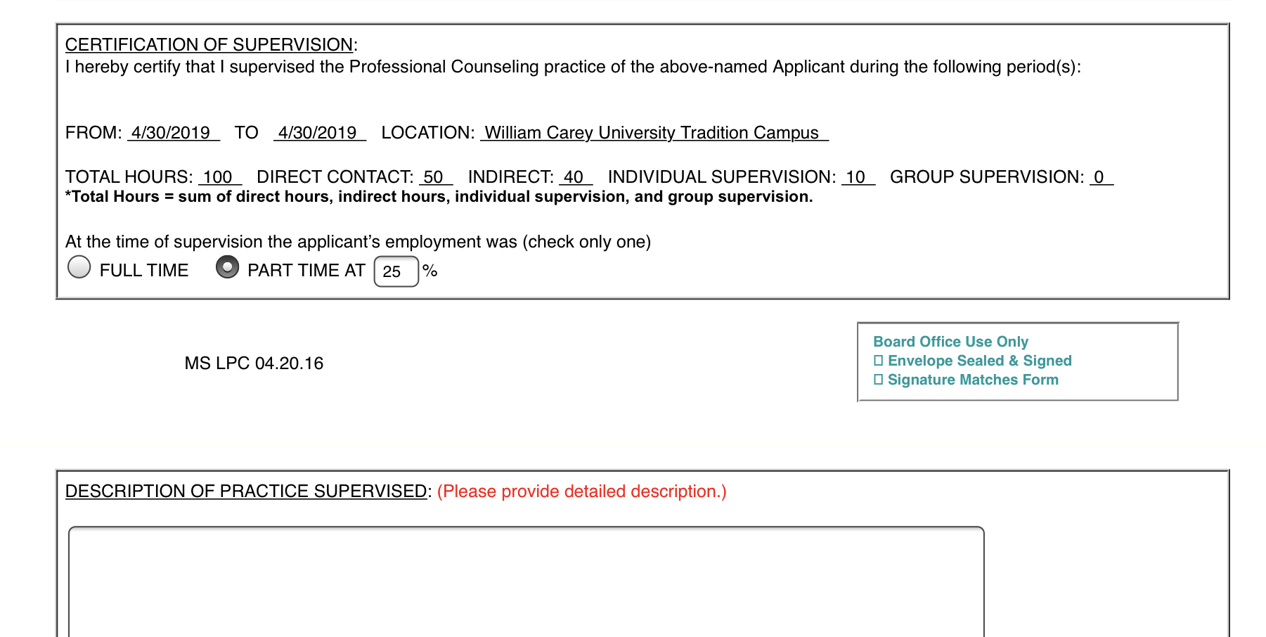
Complete Description of Practice

Slide 11
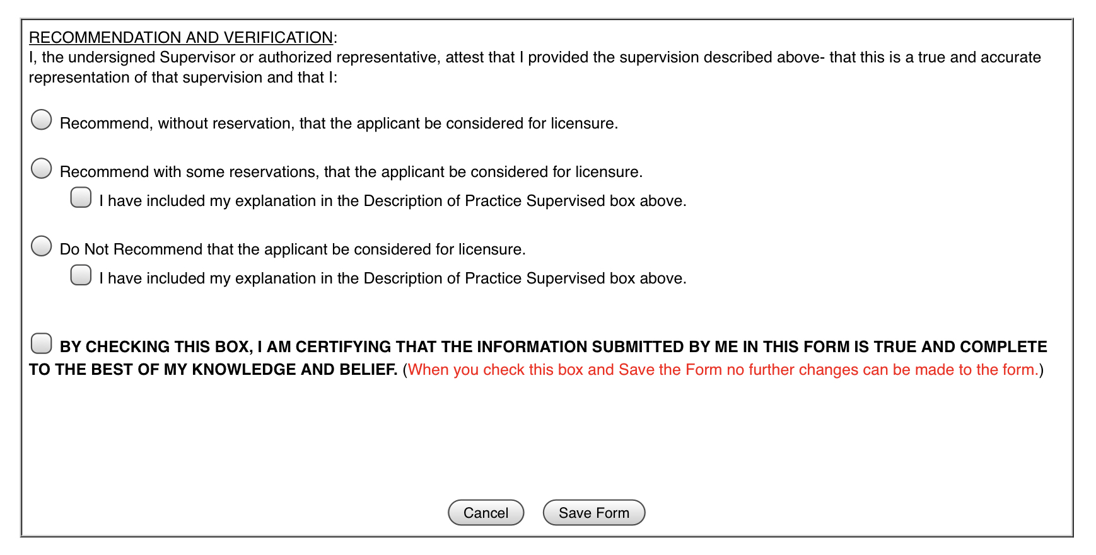
Make recommendation

Slide 12
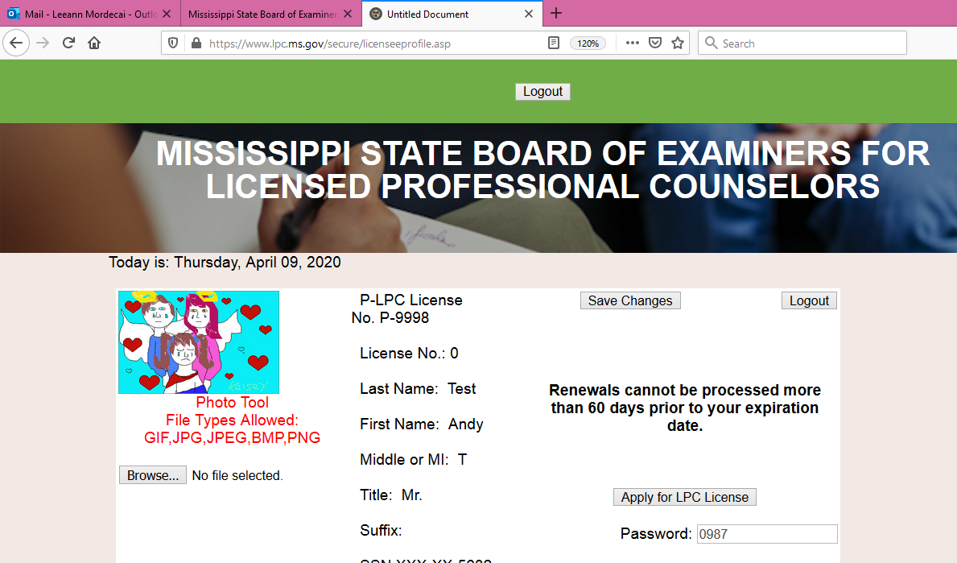

Apply for LPC

