Slide 1
Nuts and Bolts of Supervision:
Navigating Provisional Licensure
Mississippi LPC Association
May 17, 2019
Notes:
RS

Slide 2
LPC Board Members
Richard Strebeck, PhD, LPC-S, NCC, CSAT
  Chair, Long Beach (District At Large) – Counselor Educator - 2022
Victoria Williams, MS, LPC-S
  Vice-chair, Biloxi, (District IV) – Practitioner – 2023
Kimberly Elam Sallis, PhD, LPC-S
  Secretary, Oxford (District I) – Practitioner – 2021
Steven Rollins Stafford, MS, LPC-S
  Madison (District III) – Practitioner - 2022
S. Lynn Etheridge, JD, PhD, LPC-S, RPTS, NCC
  Port Gibson, (District II) – Counselor Educator – 2023
Notes:
RS

Slide 3

Board Updates
New Board members
Revised Rules and Regulations
  June 29, 2018 – Filed with the Occupational Licensing Review Committee (OLRC)
  July 10, 2018 – Filed with Secretary of State’s Office (SOS)
  March 25, 2019 – Board voted to file Emergency Rules and Regulations to the SOS
  April 15, 2019 – Met with OLRC, approved pending proclamation
R&R

Slide 4
Provisional Licensed Professional Counselor (P-LPC)
Application requirements
  Complete 60 graduate semester hour (90 quarter hour) master’s degree, which includes the 12 course content areas
  Pass the National Counselor Exam
    Does not require Board approval…even though the NBCC site indicates differently.
Notes:
SS/VW
Cannot piecemeal degree
NCE can be taken prior to degree confirmation

Slide 5
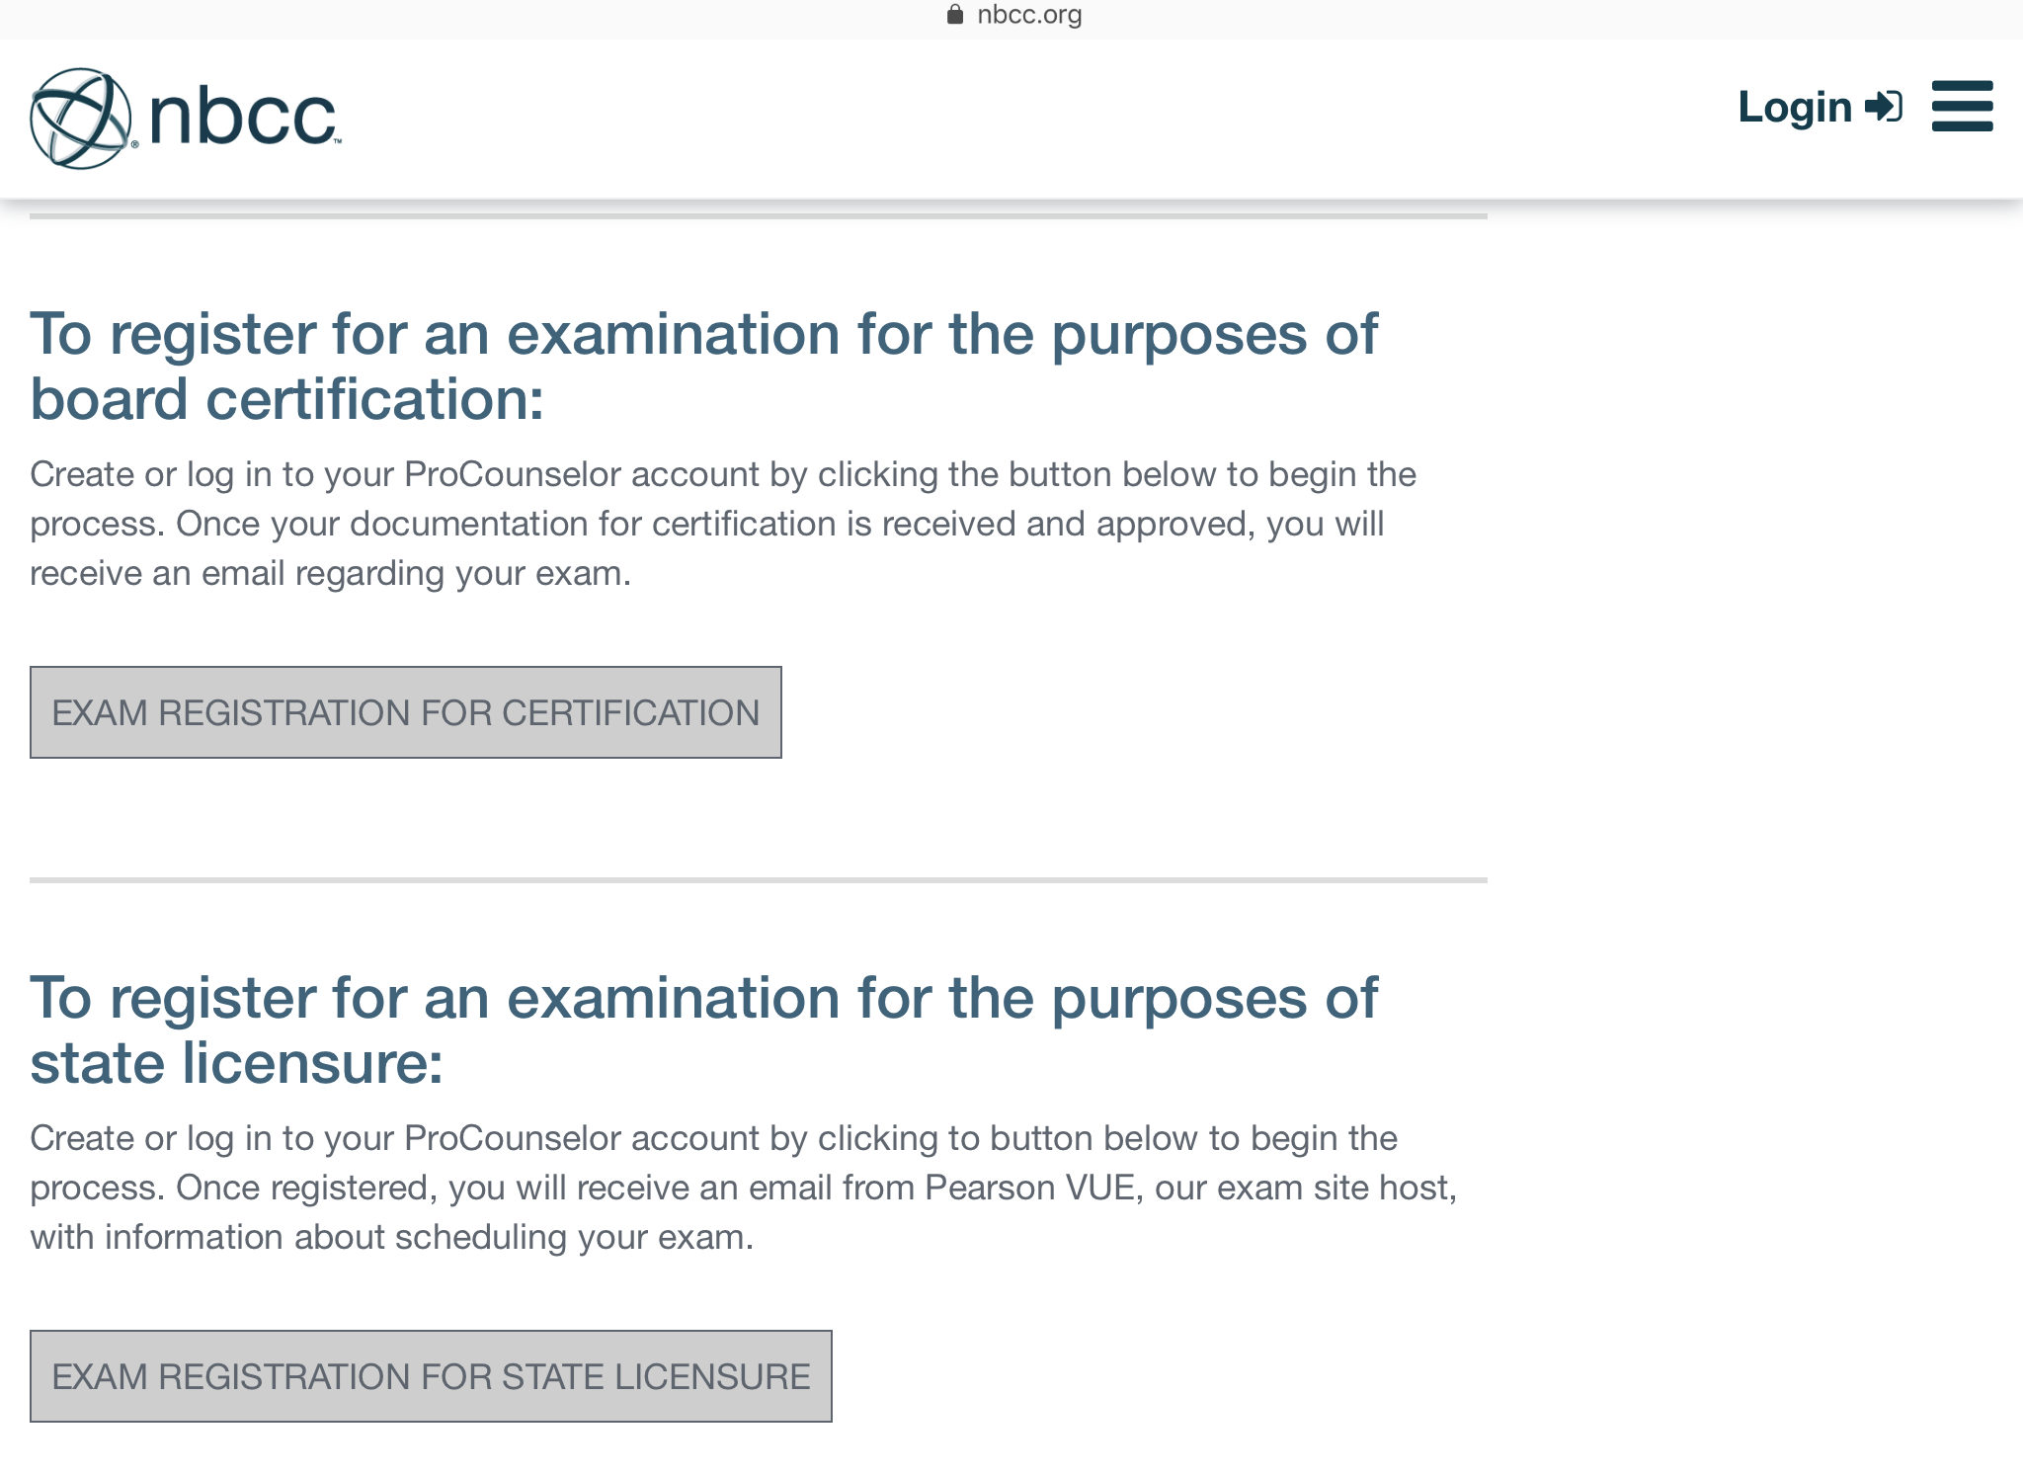
Do not apply for board certification
Make sure to apply for state licensure
Notes:
SS/VW
Cannot piecemeal degree
NCE can be taken prior to degree confirmation

Slide 6
Provisional Licensed Professional Counselor (P-LPC)
Application requirements
  Submit Declaration of Practice indicating clinical setting
  Submit supervision contract
  Complete Application and Pay Application Fee
Notes:
SS/VW

Slide 7
Supervision Contract Requirements
Register the supervision agreement online through the Board’s web portal.
Notes:
KS/LE

Slide 8
Supervised Experience Requirements
The new Rules and Regulations - someone with a P-LPC can practice at a private practice setting (a “non-governed by” setting) with an LPC onsite.
Prior Rules and Regulations required an individual with an LPC-S onsite.
Notes:
KS/LE

Slide 9
Supervised Experience requirements for the LPC
LPC requirements (Beginning July 1, 2018)
  3,000 post-masters
  1,200 direct services
  100 supervision
Notes:
KS/LE
Applicants after July 1, 2018 will not longer be able to count internship and practicum hours

Slide 10
Supervised Experience Requirements
The MS Board will only approve clinical sites in Mississippi.
A Mississippi LPC-S cannot practice (supervise hours) in another state…without being appropriately licensed in that state.
Notes:
KS/LE

Slide 11
Supervised Experience Requirements
What if I live in a “border town”?
Example: What if I want to practice in Waveland, MS and Slidell, LA.
  You must follow the Laws and Rules and Regulations for Mississippi and Louisiana.
  If verified by the LA Board, The MS Board would consider accepting the hours accrued in LA for a MS LPC.
Notes:
KS/LE

Slide 12
P-LPC Registration and Application Process

Slide 13
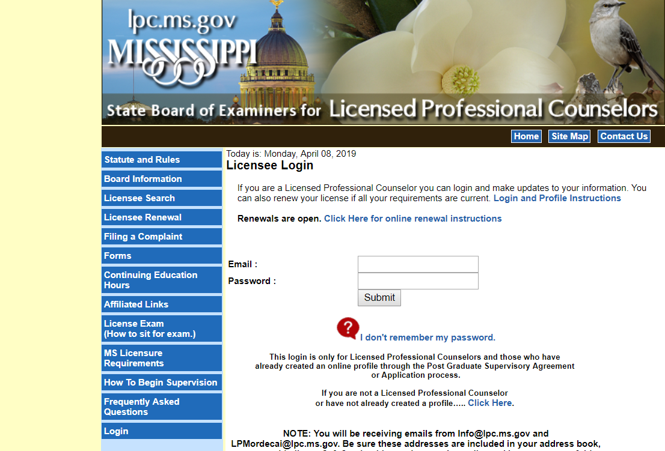

Slide 14
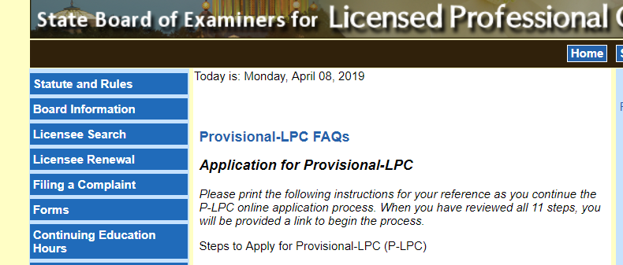
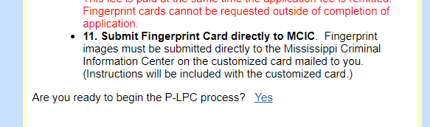

Slide 15
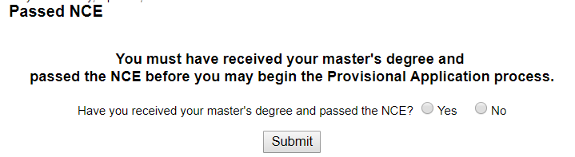

Slide 16
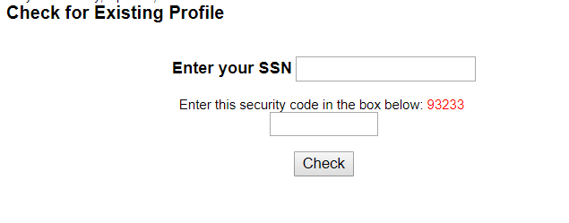

Slide 17
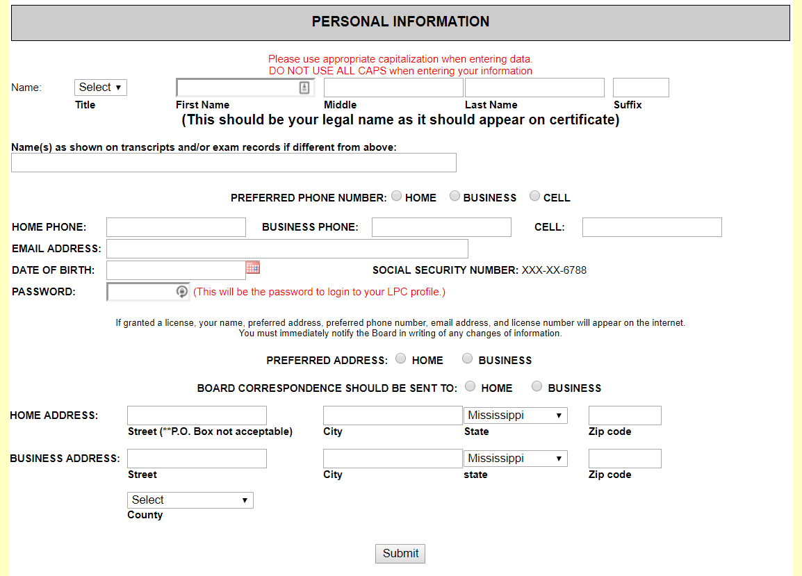
Complete personal information

Slide 18
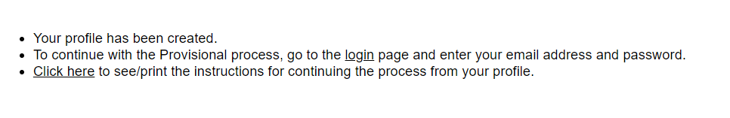

Slide 19
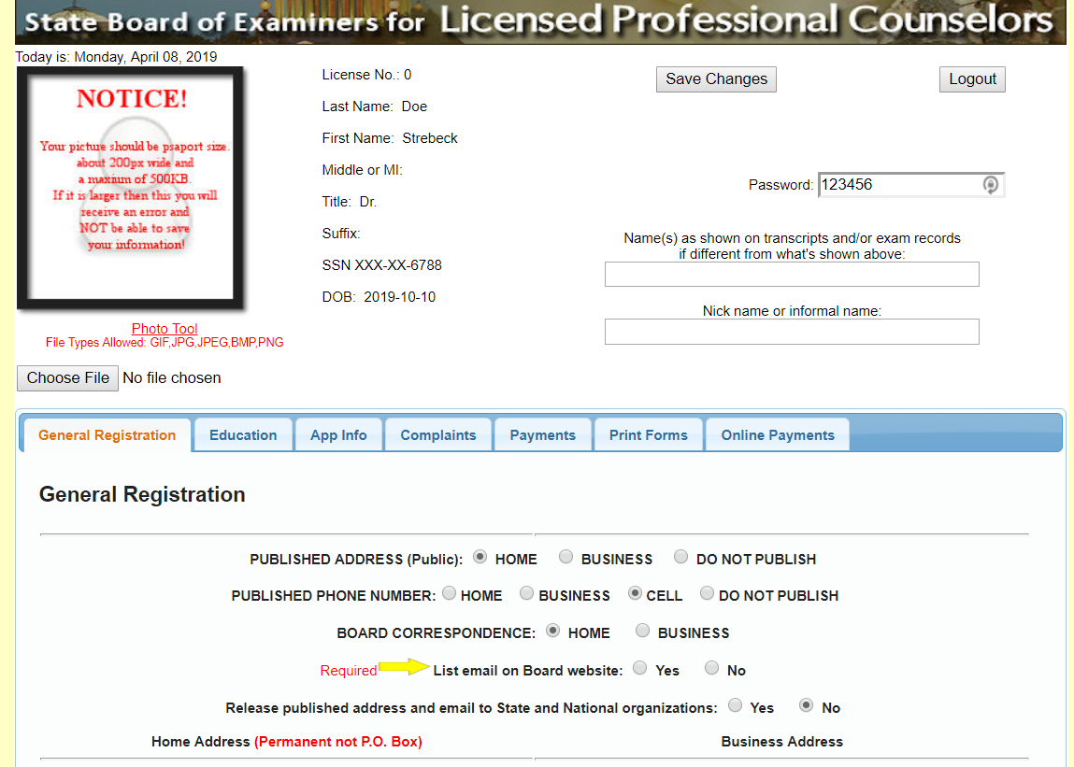
Complete General Information

Slide 20
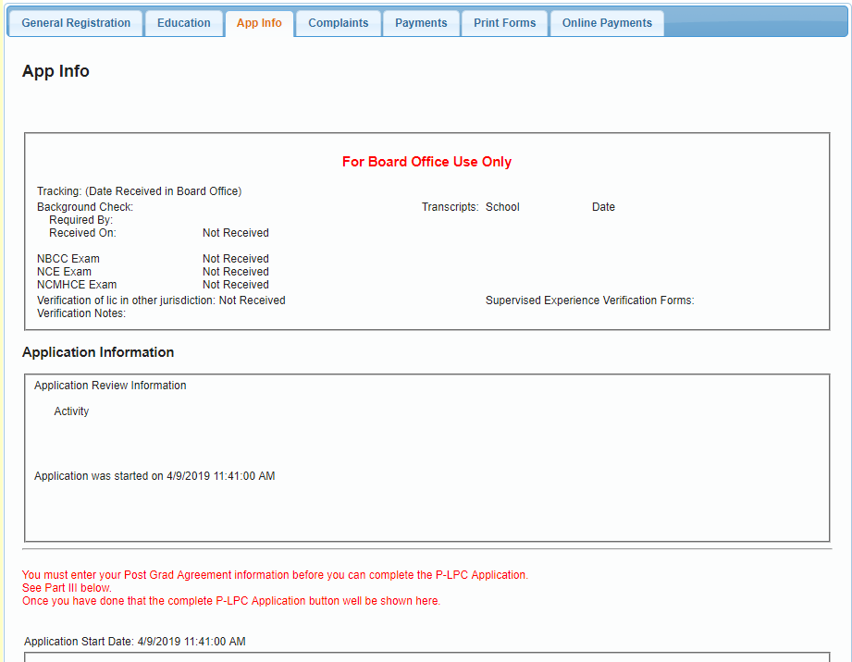
Application
information is
posted here

Slide 21
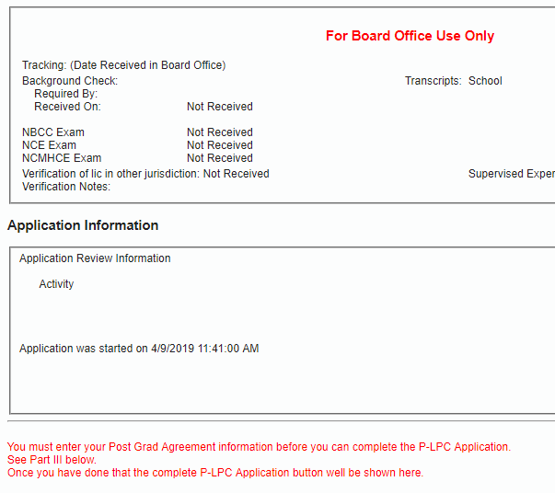
Application
information is
posted here
Follow these directions…

Slide 22
Follow these directions… Because you cannot apply for a
P-LPC without a supervisor
Part III is at the BOTTOM of the page

Slide 23
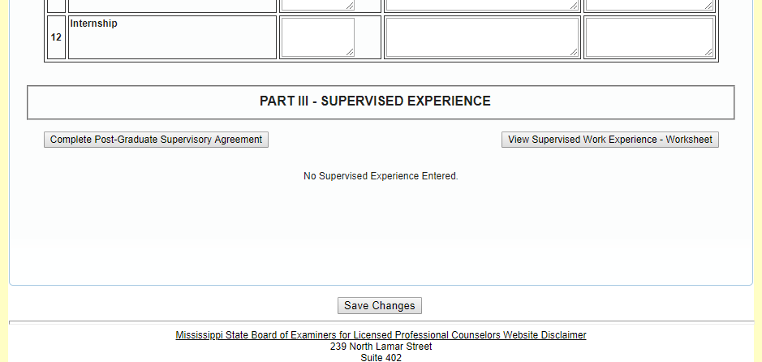

Slide 24
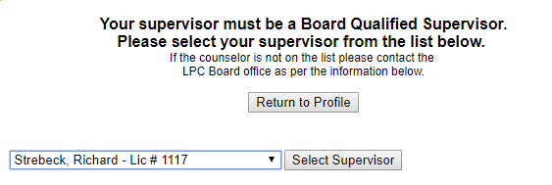

Slide 25
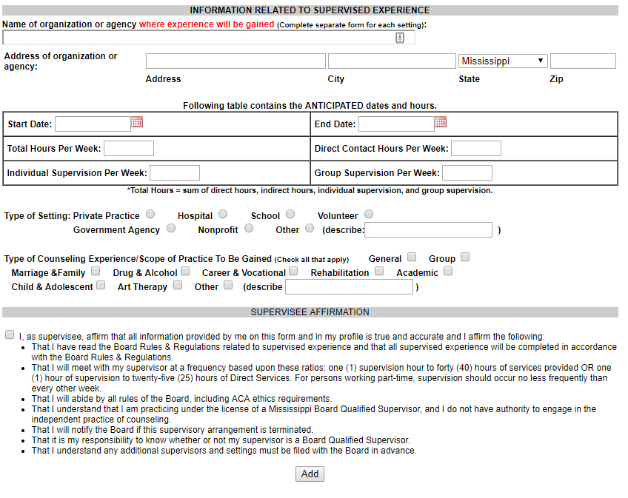
Complete supervised experience information

Slide 26
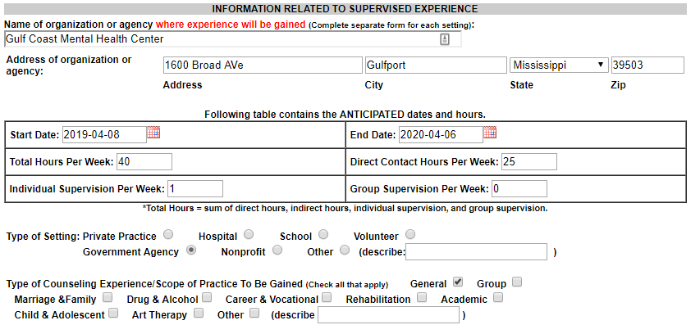

Slide 27
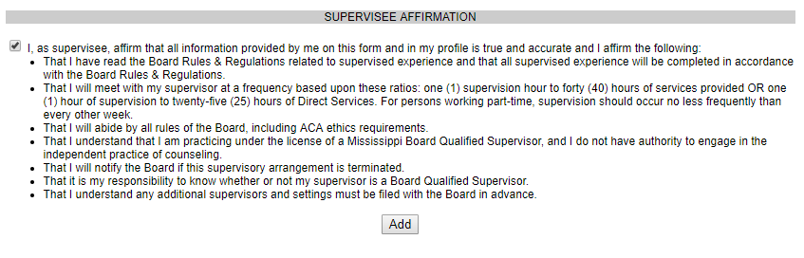

Slide 28
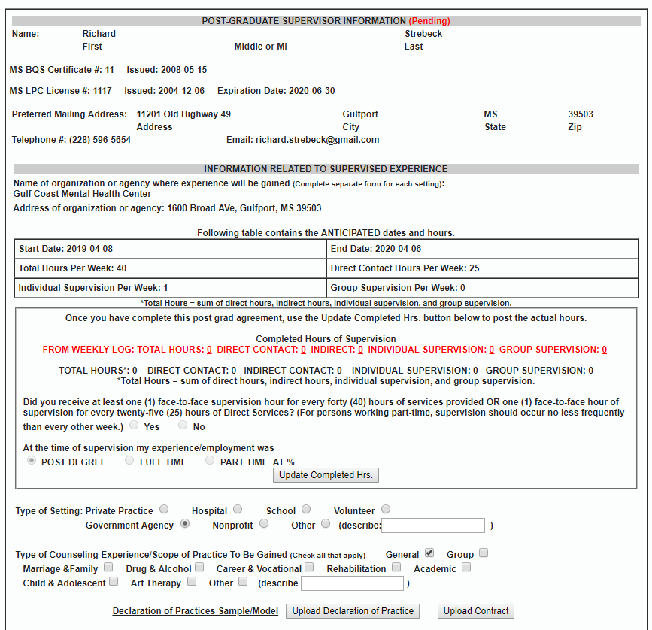
Your supervision
Information is
Posted under the
“App Info” tab
Upload your:
Declaration of Practice
Supervision Contract

Slide 29
Declaration of Practice
Basically, informed consent for site setting for supervisee
Individuals with a P-LPC practicing in a non-governed by setting (e.g., private practice, etc.) are encouraged to have clients sign this declaration as part of his/her Informed Consent process.
Notes:
SS/VW
DoP required regardless of setting of practice
Added by RS - For non-governed by settings, location/address and LPC onsite while P-LPC is providing services must be clearly documented.

Slide 30
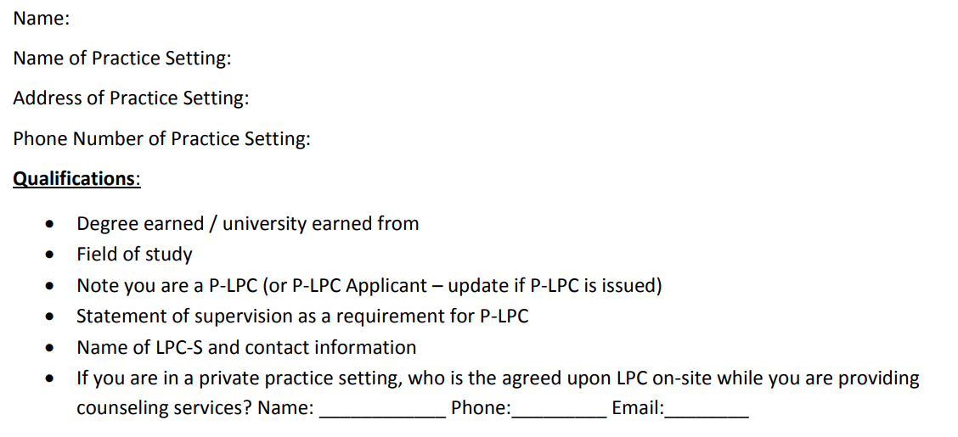
Declaration of Practice
Declaration of Practice

Slide 31
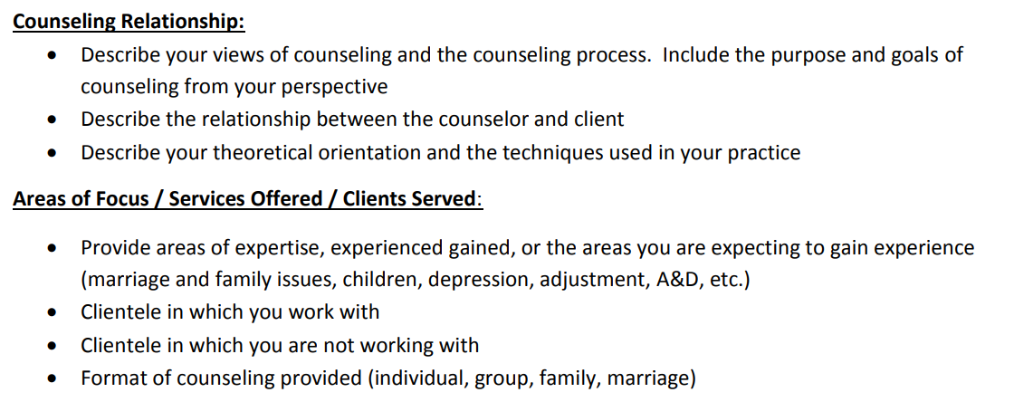
Declaration of Practice

Slide 32
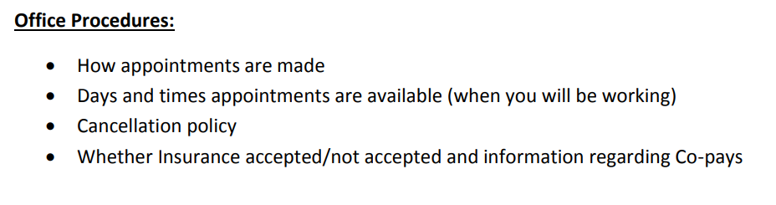
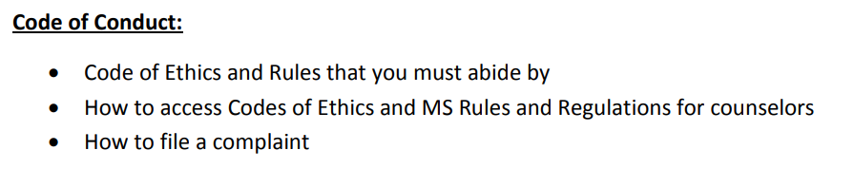
Declaration of Practice

Slide 33
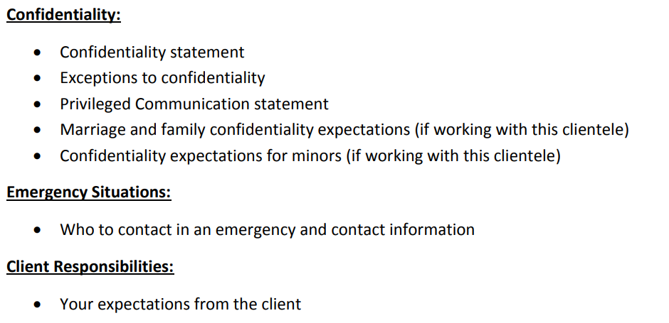
Declaration of Practice

Slide 34
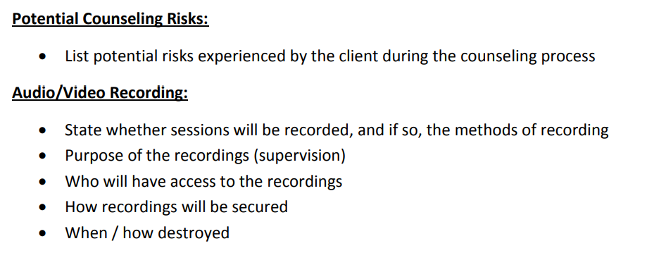
Declaration of Practice

Slide 35
Supervision Contract
Upload the signed supervision contract to the Board’s portal
  Brief philosophy of supervision (1-2 paragraphs)
  Expectations of supervisee
  Supervisor and supervisee responsibilities
  Back up LPC-S for when supervisor is out of pocket
  Terms of supervision (including fees)
  Signatures of supervisor and supervisee
Notes:
KS/LE

Slide 36
Supervision by Distance Professional Services
  Supervision can be provided by way of Distance Professional Services.
    Complete the Board Certified TeleMental Health (BC-TMH) credential through CCE.
    File the BC-TMH credential with the Board.
    Conferencing/supervision is only allowed via secure synchronous video.
    The Supervision Agreement submitted to the Board must explain the use and limits of distance supervision.
Notes:
KS/LE
Any person that provides counseling or supervision services through the means of Distance Professional Services must be licensed both in the location where services are provided by the professional as well as in the location of the recipient of the services

Slide 37
Declaration of Practice
Supervisee will upload to Board’s web portal.
Supervisor will ‘concur’.
Notes:
SS/VW

Slide 38
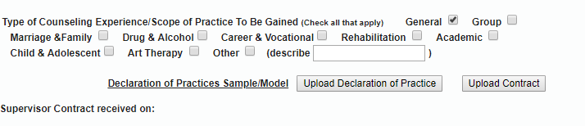
Upload your:
Declaration of Practice and Supervision Contract
Your LPC-S will concur with your Declaration of Practice.

Slide 39
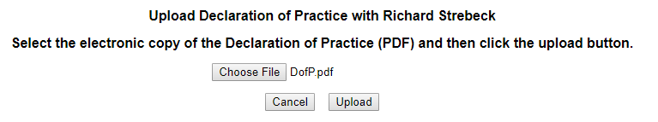
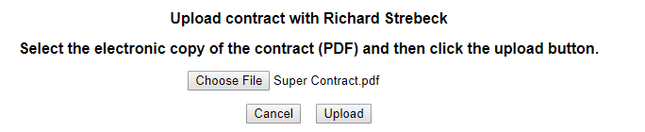

Slide 40
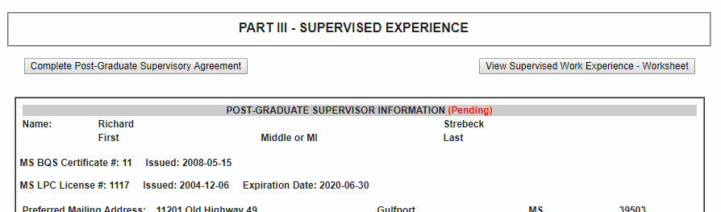
At this point, your LPC-S must agree to your supervision using the Board’s online portal.
Once your LPC-S concurs, the beginning date will show

Slide 41
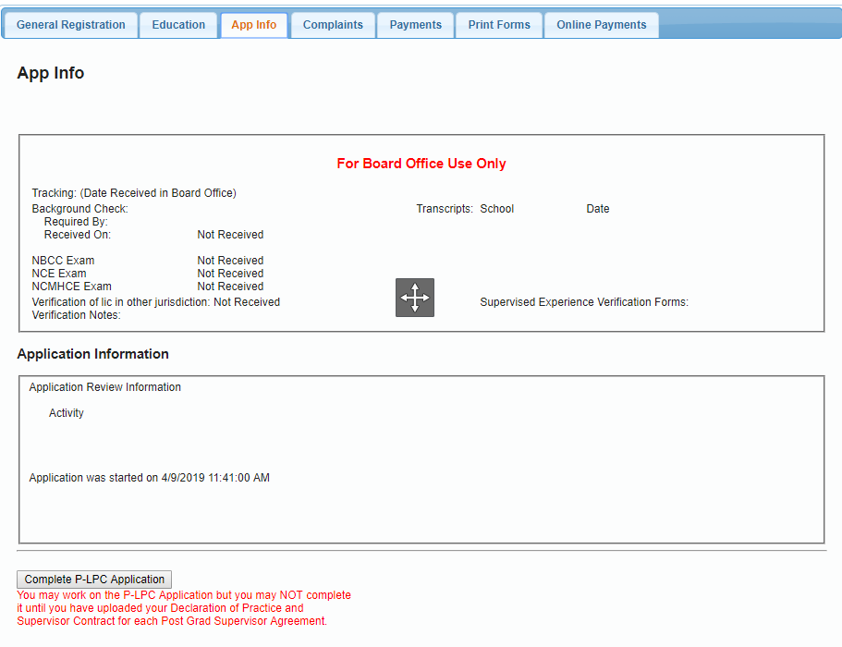

Slide 43
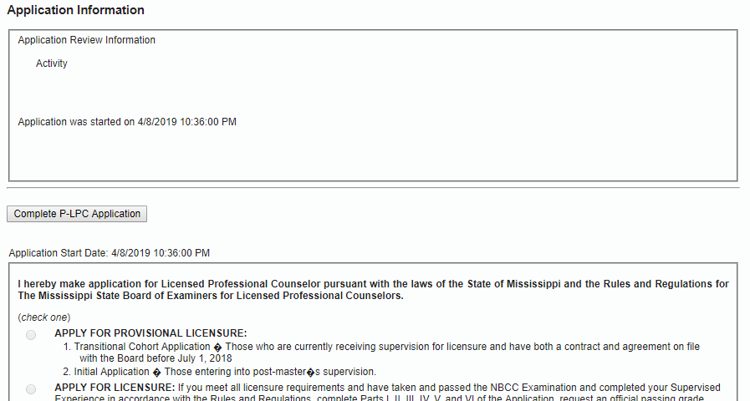
If your LPC-S accepted your request for supervision, you will see this button…without the message

Slide 44
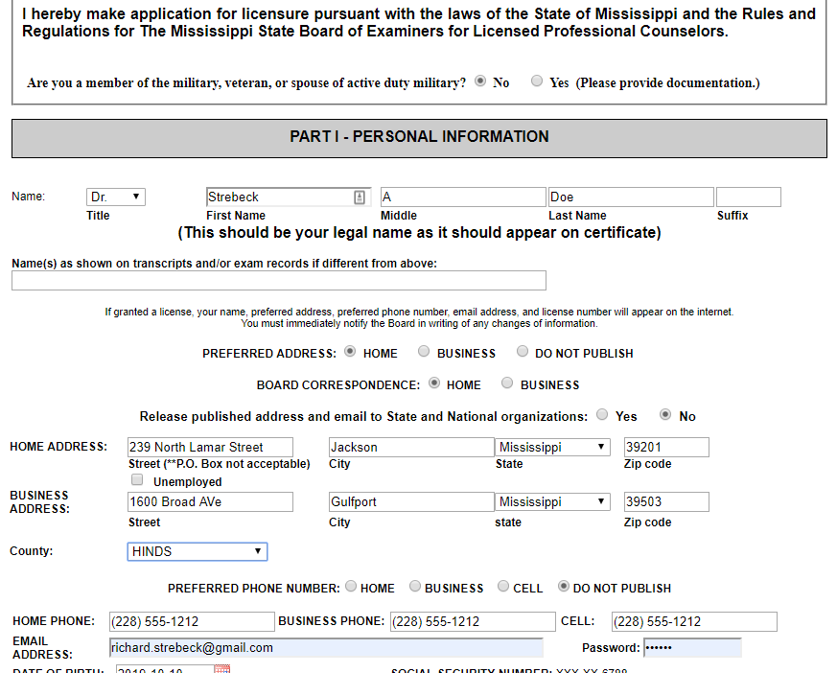
Complete information
Verify Information

Slide 45
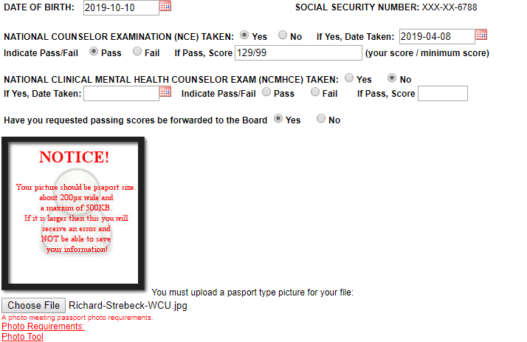
Complete information
Upload picture
(Passport style)

Slide 46
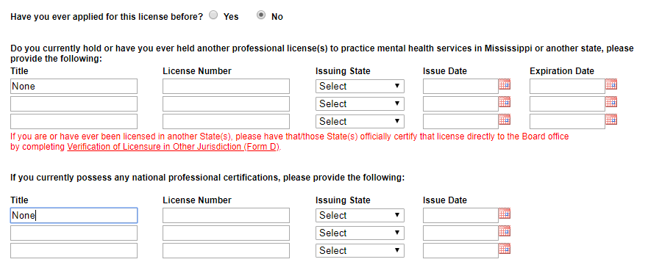
Complete information

Slide 47
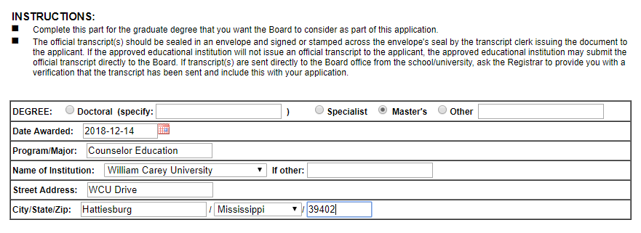

Slide 48
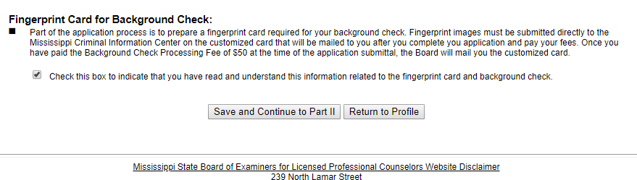

Slide 49
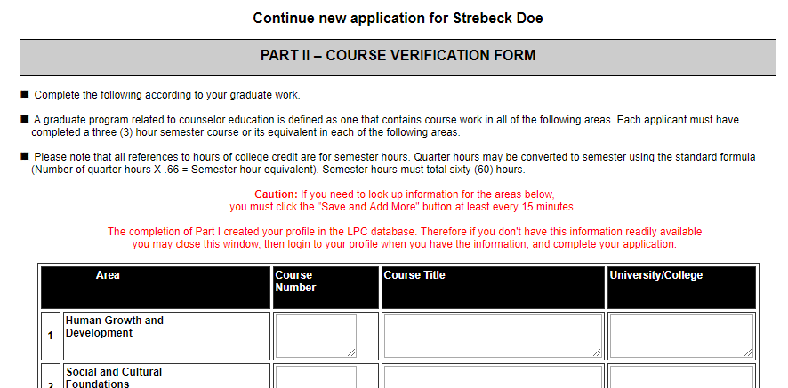
Complete information – as reflected on your
transcript(s)

Slide 50
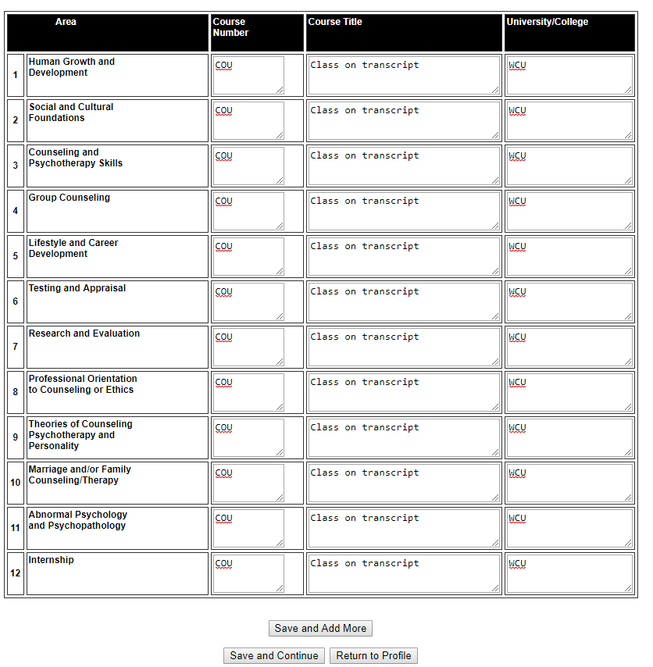
Enter the appropriate
classes as listed on
your transcript

Slide 51
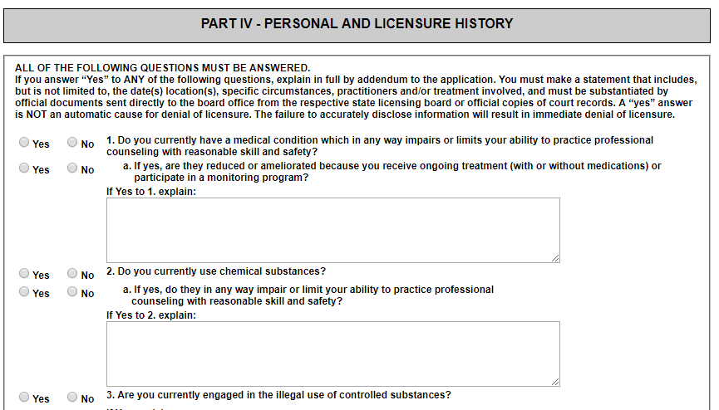
Attestations
Fully disclose
Information
If necessary, send supporting documents

Slide 52
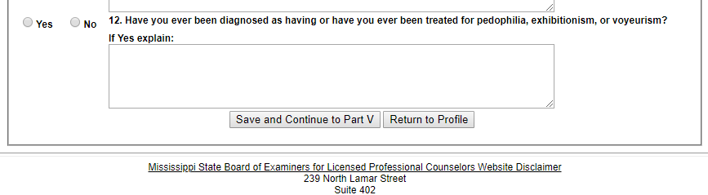

Slide 53
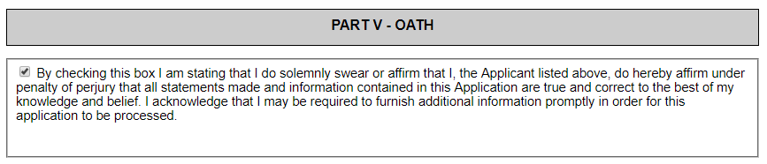

Slide 54
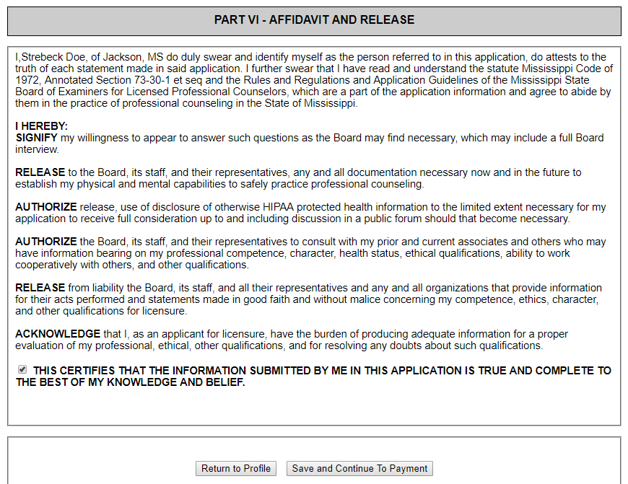
If your LPC-S has accepted the online request to supervise you, then you can complete the application and make payment

Slide 55
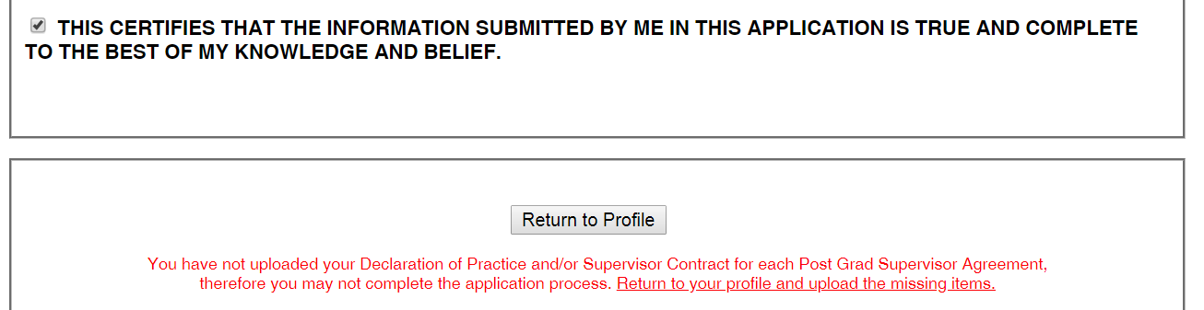
Otherwise, you get this screen ……
You cannot complete the application process until your
LPC-S accepts your online request for supervision.

Slide 56
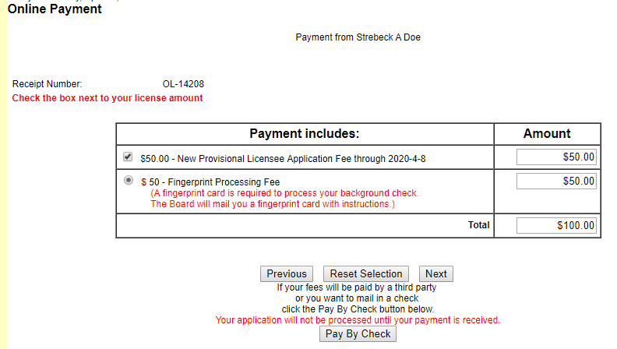

Slide 57
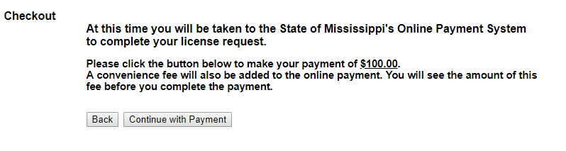

Slide 58
