Slide 1
Nuts and Bolts of Supervision:
Navigating Provisional Licensure
Mississippi LPC Association
May 17, 2019
Notes:
RS

Slide 2
LPC Board Members
Richard Strebeck, PhD, LPC-S, NCC, CSAT
  Chair, Long Beach (District At Large) – Counselor Educator - 2022
Victoria Williams, MS, LPC-S
  Vice-chair, Biloxi, (District IV) – Practitioner – 2023
Kimberly Elam Sallis, PhD, LPC-S
  Secretary, Oxford (District I) – Practitioner – 2021
Steven Rollins Stafford, MS, LPC-S
  Madison (District III) – Practitioner - 2022
S. Lynn Etheridge, JD, PhD, LPC-S, RPTS, NCC
  Port Gibson, (District II) – Counselor Educator – 2023
Notes:
RS

Slide 3

Board Updates
New Board members
Revised Rules and Regulations
  June 29, 2018 – Filed with the Occupational Licensing Review Committee (OLRC)
  July 10, 2018 – Filed with Secretary of State’s Office (SOS)
  March 25, 2019 – Board voted to file Emergency Rules and Regulations to the SOS
  April 15, 2019 – Met with OLRC, approved pending proclamation
R&R

Slide 4
Provisional Licensed Professional Counselor (P-LPC)
Application requirements
  Complete 60 graduate semester hour (90 quarter hour) master’s degree, which includes the 12 course content areas
  Pass the National Counselor Exam
    Does not require Board approval…even though the NBCC site indicates differently.
Notes:
SS/VW
Cannot piecemeal degree
NCE can be taken prior to degree confirmation

Slide 5
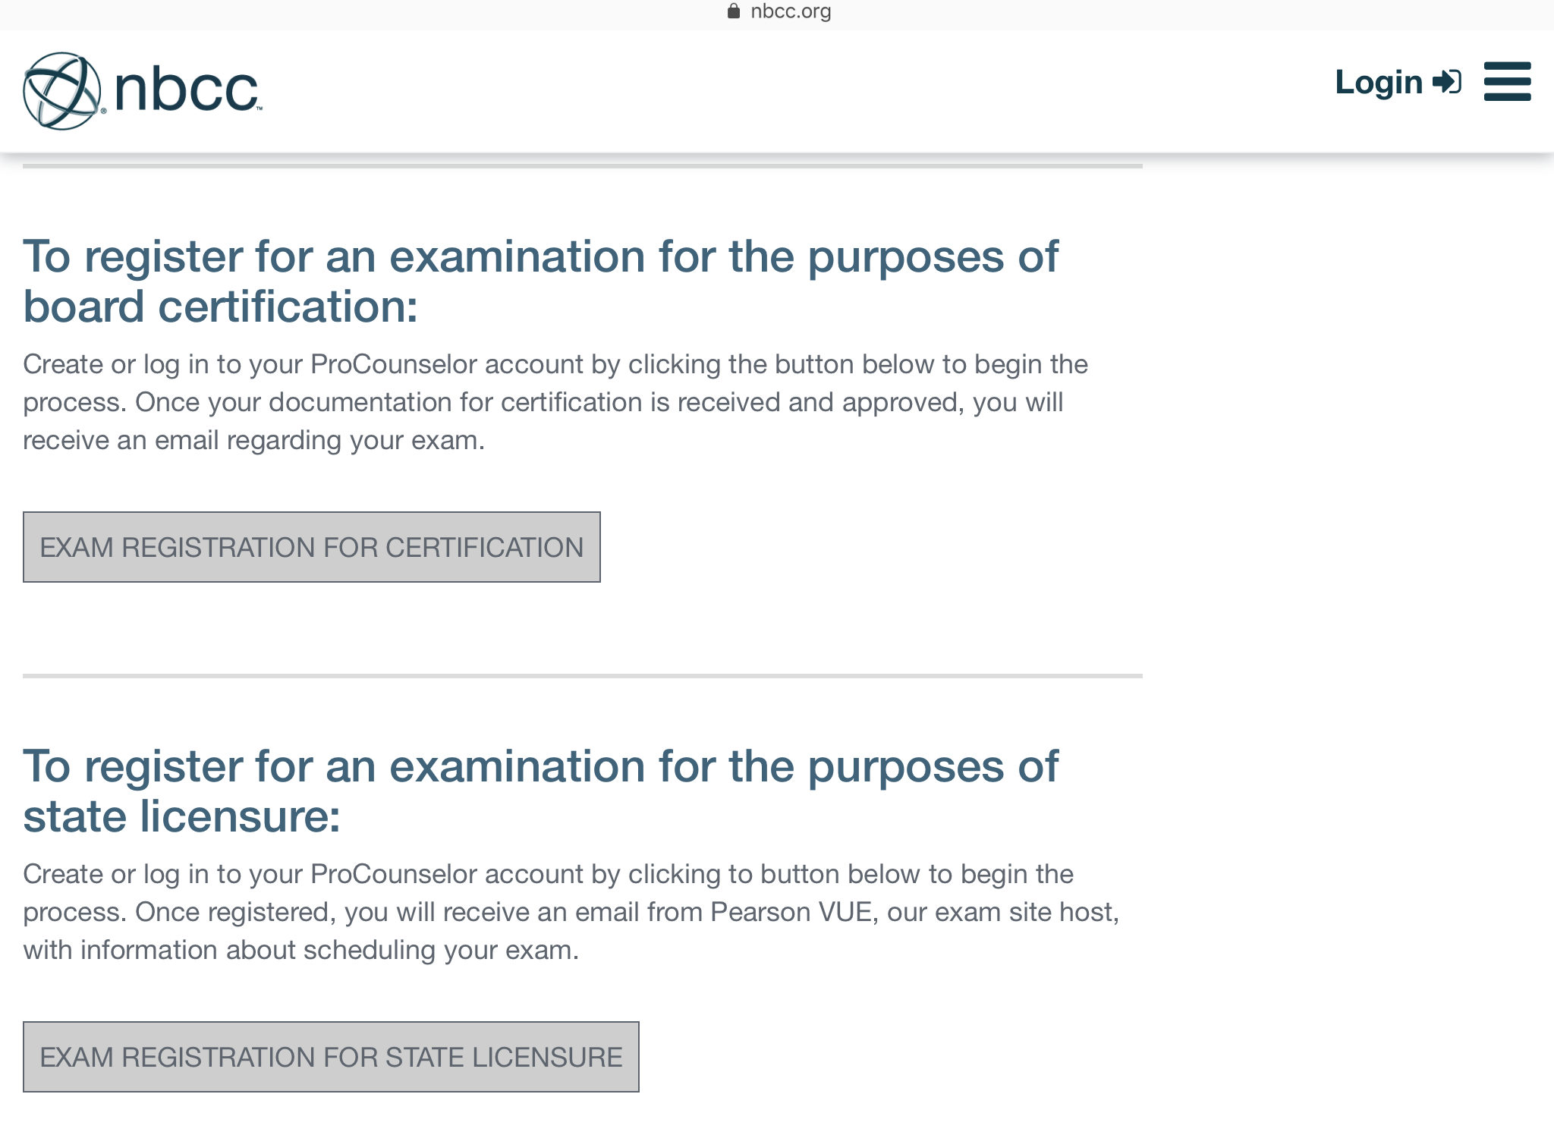
Do not apply for board certification
Make sure to apply for state licensure
Notes:
SS/VW
Cannot piecemeal degree
NCE can be taken prior to degree confirmation

Slide 6
Provisional Licensed Professional Counselor (P-LPC)
Application requirements
  Submit Declaration of Practice indicating clinical setting
  Submit supervision contract
  Complete Application and Pay Application Fee
Notes:
SS/VW

Slide 7
Supervised Experience Requirements
The new Rules and Regulations - someone with a P-LPC can practice in a private practice setting (a “non-governed by” setting) with an LPC onsite.
Prior Rules and Regulations required an individual with an LPC-S onsite.
Notes:
KS/LE

Slide 8
Supervised Experience Requirements
The MS Board will only approve clinical sites in Mississippi.
A Mississippi LPC-S cannot practice (supervise hours) in another state…without being appropriately licensed in that state.
Notes:
KS/LE

Slide 9
Supervised Experience Requirements
What if I live in a “border town”?
Example: What if I want to practice in Waveland, MS and Slidell, LA.
  You must follow the Laws and Rules and Regulations for Mississippi and Louisiana.
  If verified by the LA Board, The MS Board would consider accepting the hours accrued in LA for a MS LPC.
Notes:
KS/LE

Slide 10
Declaration of Practice
Basically, informed consent for site setting for supervisee
Individuals with a P-LPC practicing in a non-governed by setting (e.g., private practice, etc.) are encouraged to have clients sign this declaration as part of his/her Informed Consent process.
Notes:
SS/VW
DoP required regardless of setting of practice
Added by RS - For non-governed by settings, location/address and LPC onsite while P-LPC is providing services must be clearly documented.

Slide 11
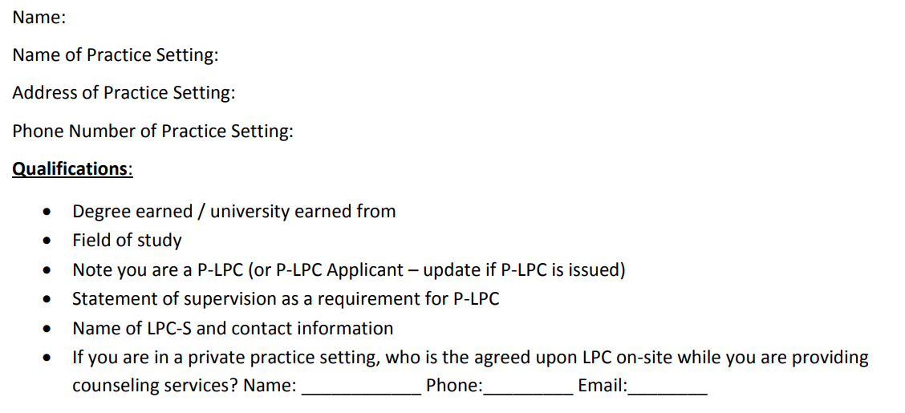
Declaration of Practice
Declaration of Practice

Slide 12
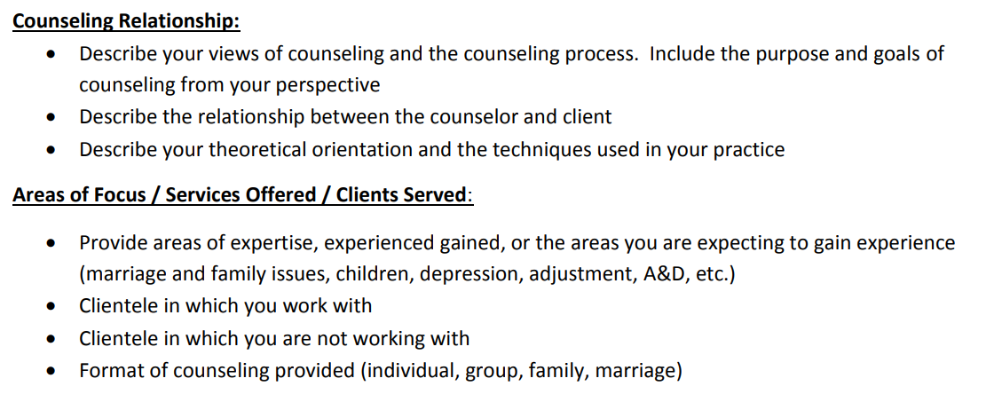
Declaration of Practice

Slide 13
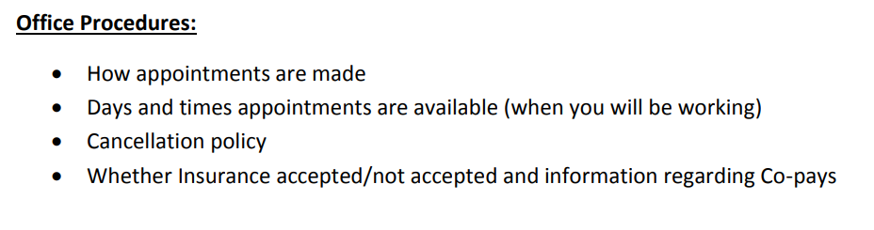
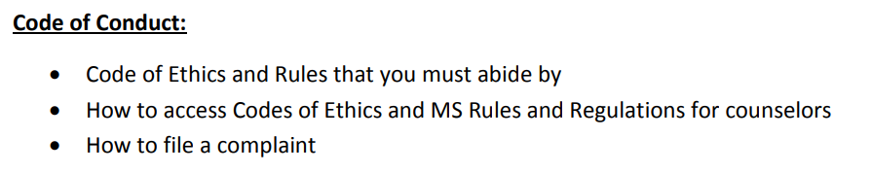
Declaration of Practice

Slide 14
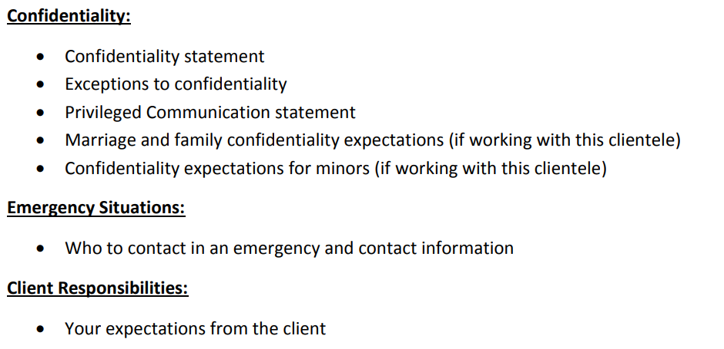
Declaration of Practice

Slide 15
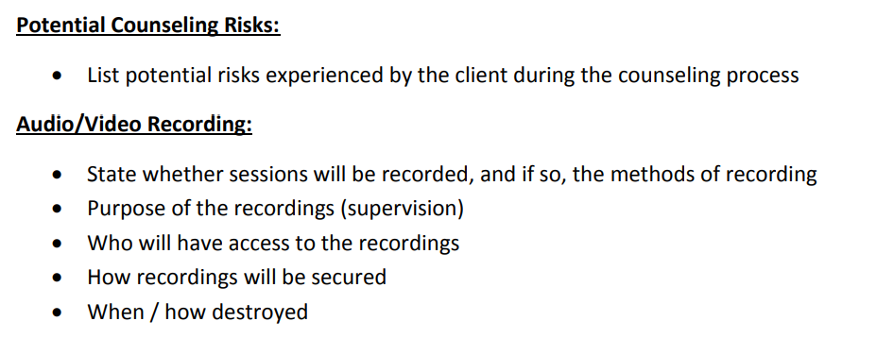
Declaration of Practice

Slide 16
Supervised Experience requirements for the LPC
LPC requirements (Beginning July 1, 2018)
  3,000 post-masters
  1,200 direct services
  100 supervision
Notes:
KS/LE
Applicants after July 1, 2018 will not longer be able to count internship and practicum hours

Slide 17
Supervision Contract Requirements
Register the supervision agreement online through the Board’s web portal.
Notes:
KS/LE

Slide 18
Supervision Contract
Upload the signed supervision contract to the Board’s portal
  Brief philosophy of supervision (1-2 paragraphs)
  Expectations of supervisee
  Supervisor and supervisee responsibilities
  Back up LPC-S for when supervisor is out of pocket
  Terms of supervision (including fees)
  Signatures of supervisor and supervisee
Notes:
KS/LE

Slide 19
Supervision by Distance Professional Services
  Supervision can be provided by way of Distance Professional Services.
    Complete the Board Certified TeleMental Health (BC-TMH) credential through CCE.
    File the BC-TMH credential with the Board.
    Conferencing/supervision is only allowed via secure synchronous video.
    The Supervision Agreement submitted to the Board must explain the use and limits of distance supervision.
Notes:
KS/LE
Any person that provides counseling or supervision services through the means of Distance Professional Services must be licensed both in the location where services are provided by the professional as well as in the location of the recipient of the services

Slide 20
Declaration of Practice
Supervisee will upload to Board’s web portal.
Supervisor will ‘concur’.
Notes:
SS/VW

Slide 21
Supervision Documentation
Progress Note
Hours Log
Form B
Update upon LPC-S renewal
Notes:
KS/LE
Applicants after July 1, 2018 will not longer be able to count internship and practicum hours

Slide 22
Supervision Documentation
Hours Log
Notes:
KS/LE
Applicants after July 1, 2018 will not longer be able to count internship and practicum hours

Slide 23
Supervision Contract Requirements
P-LPCs must report supervised hours using the online log portal provided through the LPC Board’s website.
Notes:
KS/LE

Slide 24
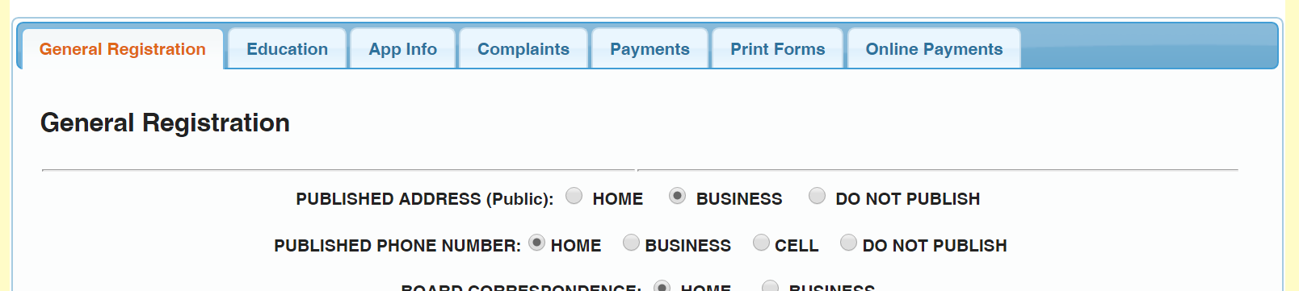
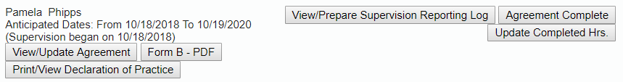
Documenting Supervised Experience

Slide 25
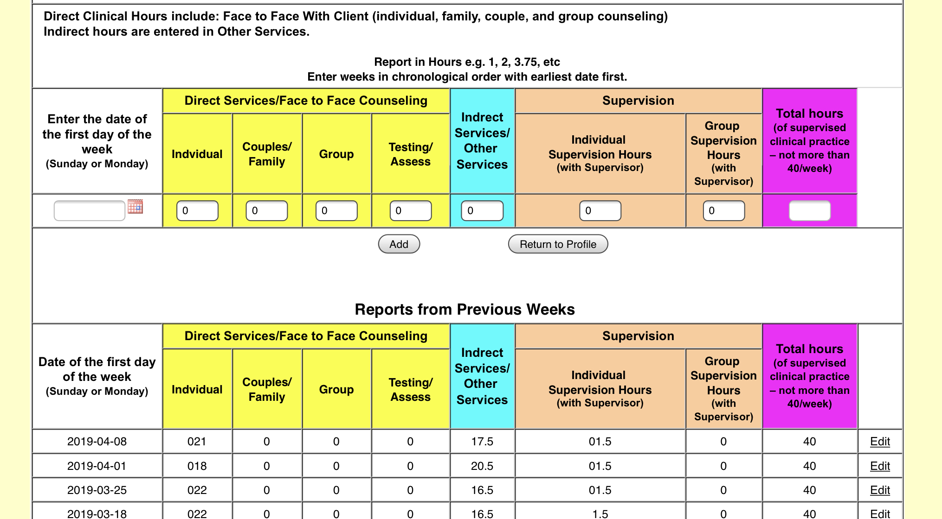
Documenting Supervised Experience
Complete during supervision
OR
Verify

Slide 26
Supervision Documentation
Form B
Notes:
KS/LE
Applicants after July 1, 2018 will not longer be able to count internship and practicum hours

Slide 27
General Registration Tab

Slide 28
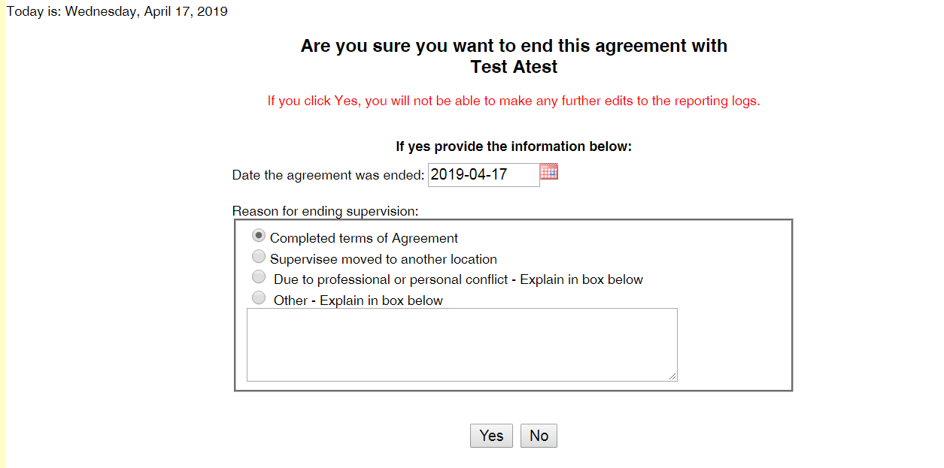

Slide 29
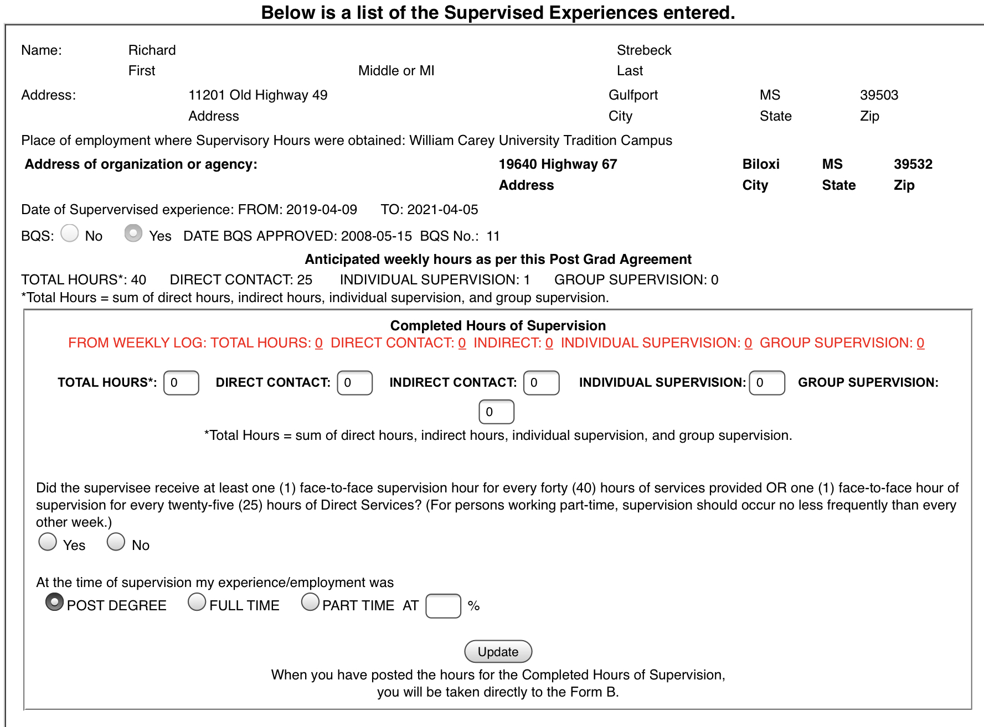
Verify/enter hours
Click update

Slide 30
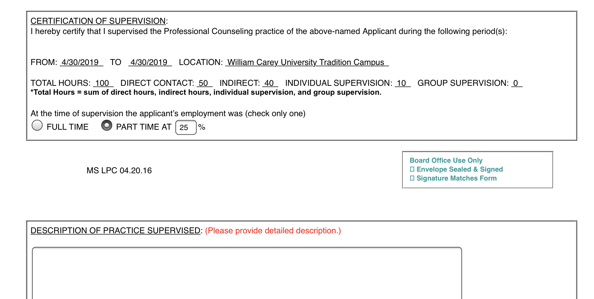
Complete Description of Practice

Slide 31
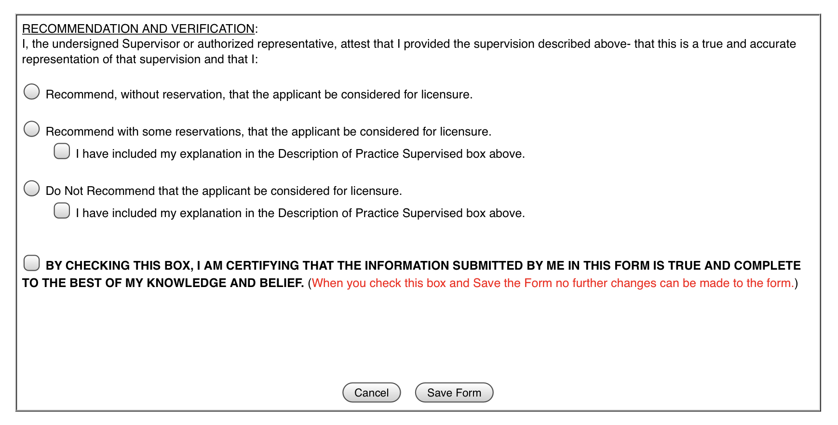
Make recommendation

