Slide 1

Rules & Regulations – What’s New and What’s Next
LPC Lunch and Learn

Slide 2
Introductions and Housekeeping

Slide 3
The Counseling Profession in MS is governed by 2 entities:
Statutes
  A written law passed by a legislative body that formally establishes legal rules, requirements, or prohibitions.
  For Licensed Professional Counselors it is Miss. Code Ann. § 73-30-1-30
Rules and Regulations
  Specific guidelines or directives created by an organization or government agency (Board) to explain how laws (statutes) will be applied and enforced
Statutes vs Rules and Regulations

Slide 4
Statutes
Written into law by the legislature
Board does not have authority to change statutes
Board serves in a regulatory role; therefore, lobbying for changes in the law is not in their purview
Mississippi Counseling Association, on behalf of the counseling profession, has the lobbying capacity for any changes made to the law
Any member of the public and any licensee can also lobby the legislature for statute changes

Slide 5
Proposed Statute Changes
The Board has presented 2 potential changes to our statute to MCA to take under advisement:
  To add Summary Suspension language
    (7) Nothing in this subsection shall be interpreted to prohibit the board from immediately suspending any license prior to a hearing under subsection (3) of this section, when in its sole discretion the suspension is required for the instruction, safety, or well-being of any member of the public.
  To delete Miss. Code Ann. § 73-30-21 (4)
    (4) No revoked license or privilege to practice may be reinstated within twelve (12) months after such revocation. Reinstatement thereafter shall be upon such conditions as the board may prescribe, which may include, without being limited to, successful passing of the examination required by this chapter.
Notes:
We have worked with MCA beginning in 2024 for changes to our statutes

Slide 6
Rules Changes Effective September 16, 2025
When the Board determines a change to the Rules and Regulations is necessary, the process for that change is as follows:
  Board revises/writes new rules and approves
  Post for 30-day comment period
  Board reviews comments and makes final revisions
  Submit to Occupational Review Licensing Commission (OLRC)
  Meet with OLRC
  Make changes required by OLRC
  Send to OLRC as Final
  File with Secretary of State
  Implement 30 days post finalized

Slide 7
Previous vs Current
Rule 1.4.CC
Previous
Definitions
Retired Status: An LPC, who, of his/her/their own volition, chooses to cease practice. This category is not related to any disciplinary action which would be the cause of ceasing to practice. An LPC’s request for retired status is subject to Board approval. A Licensee in Retired Status cannot practice as an LPC in Mississippi. Retired Status is a permanent status.
Current
Retired Status: An LPC, who, of his/her/their own volition, chooses to cease practice. This category is not related to any disciplinary action which would be the cause of ceasing to practice. A Licensee in Retired Status cannot practice as an LPC in Mississippi. Retired Status is a permanent status.
Notes:
The Board does not need to approve someone wanting to retire their license. This is not a regulatory need. We also removed this wording from Rule 5.4 Licensure Categories for Retired Status.

Slide 8
Previous vs Current
Rule 4.3.B.1
Previous
Requirements to Become a Licensed Professional Counselor (LPC)
B. Supervision Requirements: An Applicant for independent practice licensure must document the following supervised experience requirements prior to applying for licensure. The supervisor must be a Mississippi Board qualified supervisor (LPC-S).
A total of three thousand (3,000) supervised hours in not less than eighteen (18) months of counseling in a clinical setting post master’s degree (as referenced in Rule 1.4) comprised of the following:
  A maximum of forty (40) supervised hours may be obtained per workweek
  A maximum of twenty-five (25) hours of direct service may be obtained per 40-hour workweek
  A minimum of one thousand two hundred (1200) supervised hours must be in Direct Services with clients and/or psychotherapy services to clients. Direct Services are only face-to-face or synchronous methods of counseling including individual counseling, couples/family counseling, group counseling, and testing and assessment.

Slide 9
Previous vs Current
Rule 4.3.B.1
Requirements to Become a Licensed Professional Counselor (LPC)
Continued:
  One hundred (100) hours of individual face-to-face supervision are required. The Board will accept supervision hours meeting the following maximum ratios: one (1) supervision hour to forty (40) hours of services provided OR one (1) hour of supervision to twenty-five (25) hours of Direct Services. For persons working part time, supervision should occur no less frequently than every other week.
  Group supervision will be acceptable for not more than fifty (50) hours of the required one hundred (100) hours of individual supervision. Two (2) hours of group supervision is equivalent to one (1) hour of individual supervision. Total hours of group supervision should be reported in full and will then be divided by two (2) by the Board at review time.
  Individual supervision provided by multiple supervisors regarding the same direct client service hours at the same site during the same time frame will not be accepted.

Slide 10
Previous vs Current
Rule 4.3.B.1
Current
Requirements to Become a Licensed Professional Counselor (LPC)
B. Supervision Requirements: An Applicant for independent practice licensure must document the following supervised experience requirements prior to applying for licensure. The supervisor must be a Mississippi Board qualified supervisor (LPC-S).
A total of three thousand (3,000) supervised hours in not less than eighteen (18) months of counseling in a clinical setting post master’s degree (as referenced in Rule 1.4) comprised of the following:
  A maximum of forty (40) supervised hours may be obtained per workweek
  A maximum of twenty-five (25) hours of direct service may be obtained per 40-hour workweek
  A minimum of one thousand two hundred (1200) supervised hours must be in Direct Services with clients and/or psychotherapy services to clients. Direct Services are only face-to-face or synchronous methods of counseling including individual counseling, couples/family counseling, group counseling, and testing and assessment.

Slide 11
Previous vs Current
Rule 4.3.B.1
Requirements to Become a Licensed Professional Counselor (LPC)
Continued:
  One hundred (100) hours of individual face-to-face supervision are required. The Board will accept supervision hours meeting the following maximum ratios: one (1) supervision hour to forty (40) hours of services provided OR one (1) hour of supervision to twenty-five (25) hours of Direct Services. For persons working part time, supervision should occur no less frequently than every other week.
  Group supervision will be acceptable for not more than fifty (50) hours of the required one hundred (100) hours of individual supervision.
  Individual supervision provided by multiple supervisors regarding the same direct client service hours at the same site during the same time frame will not be accepted.
Notes:
In this section, we changed the group supervision requirements. Instead of dividing by .5 and all of that, we just stated that group cannot count for more than 50 of the 100 supervision hours.

Slide 12
Previous vs Current
Rule 4.4.A.5
Previous
Requirements to receive the Board qualified supervisor (LPC-S) credential include the following items:
  Have documented membership in a professional counseling organization.
Current
Rule 4.4.A.5
Deleted professional counseling organization requirement
Notes:
This is not something the board checks or regulates

Slide 13
Previous vs Current
Rule 4.12
Previous
None
Current
Rule 4.12 Professional Counseling Compact
This section is governed under the provisions of the Professional Counseling Compact found under Mississippi Code Annotated Section 73-30-51. Please refer to this code section for information regarding qualifications for a privilege to practice.
Notes:
Added a rule that addressed the compact

Slide 14
Previous vs Current
Rule 6.2.C.2.b
Previous
Continuing Education Requirements
Continuing Education Not Pre-approved. For those organizations, groups or individuals that do not carry provider status by one of the above associations, the CEH will be subject to approval by the Board at the time of renewal. The Board will not pre-approve any type of CEH. The CEH must be given by a qualified presenter. A qualified presenter is considered to be someone at the master’s level or above and trained in the mental health field or related services. One may receive one clock hour of CEH for each hour of direct participation in a structured educational format as a learner.
Credit cannot be granted for: business/governance meetings; breaks; or social activities including meal functions, except for actual time of a content speaker. Verification for workshops, seminars, or conventions should consist of copies of certificates of attendance, and other documentation, which clearly indicates learning objectives.

Slide 15
Previous vs Current
Rule 6.2.C.2.b
Current
Continuing Education Requirements
Licensees can submit a Continuing Education Verification Request to NBCC requesting their continuing education hours to be approved by NBCC.

Slide 16
Previous vs Current
Rule 8.2.C.2
Previous
Complaint Procedures
Inform the Accused a complaint has been filed against them and they are under investigation. Notice of the filed complaint shall be given within a reasonable time from the date of receipt of the complaint, not to exceed one hundred twenty (120) calendar days. The investigating Board member or investigator shall notify the counselor of the allegations and corresponding Code of Ethics, Statutes, and/or Rules and Regulations violations.
Current
Inform the Accused a complaint has been filed against them and they are under investigation. Notice of the filed complaint shall be given within a reasonable time from the date of receipt of the complaint, not to exceed one hundred eighty (180) calendar days. The investigating Board member or investigator shall notify the counselor of the allegations and corresponding Code of Ethics, Statutes, and/or Rules and Regulations violations.

Slide 17
Previous vs Current
Rule 8.6: Continuances
Previous
None
Current
A. Hearings shall be held before the full Board at the time and place designated in the summons unless a continuance is granted for just cause by the Board.
B. A motion for a continuance must be filed with the Board, in writing, at least ten (10) days prior to the scheduled hearing, or upon a showing of good cause, at any time prior to the hearing.
C. The executive director may review the first request for continuance and, after speaking with the Board attorney and investigating board member, may grant or deny the request.
D. The Board must review the second and all subsequent requests for continuance. No more than two (2) continuances of the hearing will be granted without good cause.

Slide 18
Previous vs Current
Rule 8.7: Informal Conferences
Previous
None
Current
Prior to the imposition of disciplinary sanctions against a license, the licensee may request an informal conference.
Informal conferences shall be attended by the Board attorney or designee, the investigating board member, and/or other representatives of the Board as the Chairman and Board attorney may deem necessary for the proper conduct of the conference. The licensee and/or the licensee’s attorney may attend the informal conference and shall be provided an opportunity to be heard.
The Complainant may also attend the informal conference and shall be provided an opportunity to be heard regarding charges based upon the information provided. Nothing herein requires a complainant to attend an informal conference.

Slide 19
Previous vs Current
Rule 8.7: Informal Conferences
Continued
Informal conferences are not official meetings of the Board.
A proposed order shall be presented to the Board for its review following the conclusion of an informal conference. At the conclusion of its review, the Board shall approve, amend, or disapprove the proposed order. Should the Board approve the proposed order, the appropriate notation shall be made in the minutes of the Board and the proposed order shall be entered as an official action of the Board. The Executive Director shall contact the Licensee regarding Board amendments to the proposed order where the Licensee will be given an opportunity to concur or reject the amended proposed order. If the Licensee does not concur, or the Board rejects the proposed order, the case shall be scheduled for hearing.

Slide 20
Proposed Future Changes
Rule 4.3.B
Requirements to Become a Licensed Professional Counselor (LPC)
Current
B. Supervision Requirements: An Applicant for independent practice licensure must document the following supervised experience requirements prior to applying for licensure. The supervisor must be a Mississippi Board qualified supervisor (LPC-S).
A total of three thousand (3,000) supervised hours in not less than eighteen (18) months of counseling in a clinical setting post master’s degree (as referenced in Rule 1.4) comprised of the following:
  A maximum of forty (40) supervised hours may be obtained per workweek.
  A maximum of twenty-five (25) hours of direct service may be obtained per 40-hour workweek.
  A minimum of one thousand two hundred (1,200) supervised hours must be in Direct Services with clients and/or psychotherapy service to clients. Direct Services are only face-to-face or synchronous methods of counseling including individual counseling, couples/family counseling, group counseling, and testing and assessment.
Notes:
In 2023, the board approached the

Slide 21
Proposed Future Changes
Rule 4.3.B
Requirements to Become a Licensed Professional Counselor (LPC)
Continued:
  One hundred (100) hours of individual face-to-face supervision are required. The Board will accept supervision hours meeting the following maximum ratios: one (1) supervision hour to forty (40) hours of services provided OR one (1) hour of supervision to twenty-five (25) hours of Direct Services. For persons working part time, supervision should occur no less frequently than every other week.
  Group supervision will be acceptable for not more than fifty (50) hours of the required one hundred (100) hours of individual supervision.
  Individual supervision provided by multiple supervisors regarding the same direct client service hours at the same site during the same time frame will not be accepted.

Slide 22
Proposed Future Changes
Rule 4.3.B
Proposed
Requirements to Become a Licensed Professional Counselor (LPC)
B. Supervision Requirements: An Applicant for independent practice licensure must document the following supervised experience requirements prior to applying for licensure. The supervisor must be a Mississippi Board qualified supervisor (LPC-S).
A total of three thousand (3,000) supervised hours in not less than eighteen (18) months of counseling in a clinical setting post master’s degree (as referenced in Rule 1.4) comprised of the following:
  A minimum of one thousand two hundred (1200) supervised hours must be in Direct Services with clients and/or psychotherapy services to clients. Direct Services are only face-to-face or synchronous methods of counseling including individual counseling, couples/family counseling, group counseling, and testing and assessment.
  A minimum of one hundred (100) hours of individual face-to-face or synchronous supervision is required.

Slide 23
Proposed
Rule 4.3.B
Continued
  A minimum of 2 hours of supervision is required each month
  Group supervision will be acceptable for not more than fifty (50) hours of the required one hundred (100) hours of individual supervision.
  Individual supervision provided by multiple supervisors regarding the same direct client services hours at the same site during the same time frame will not be accepted

Slide 24
Information Regarding Rule 4.3.B. Proposal
Open for comments from public until October 25
All comments will be reviewed and taken under advisement by the LPC Board
Comments will be sent with proposed change to OLRC

Slide 25
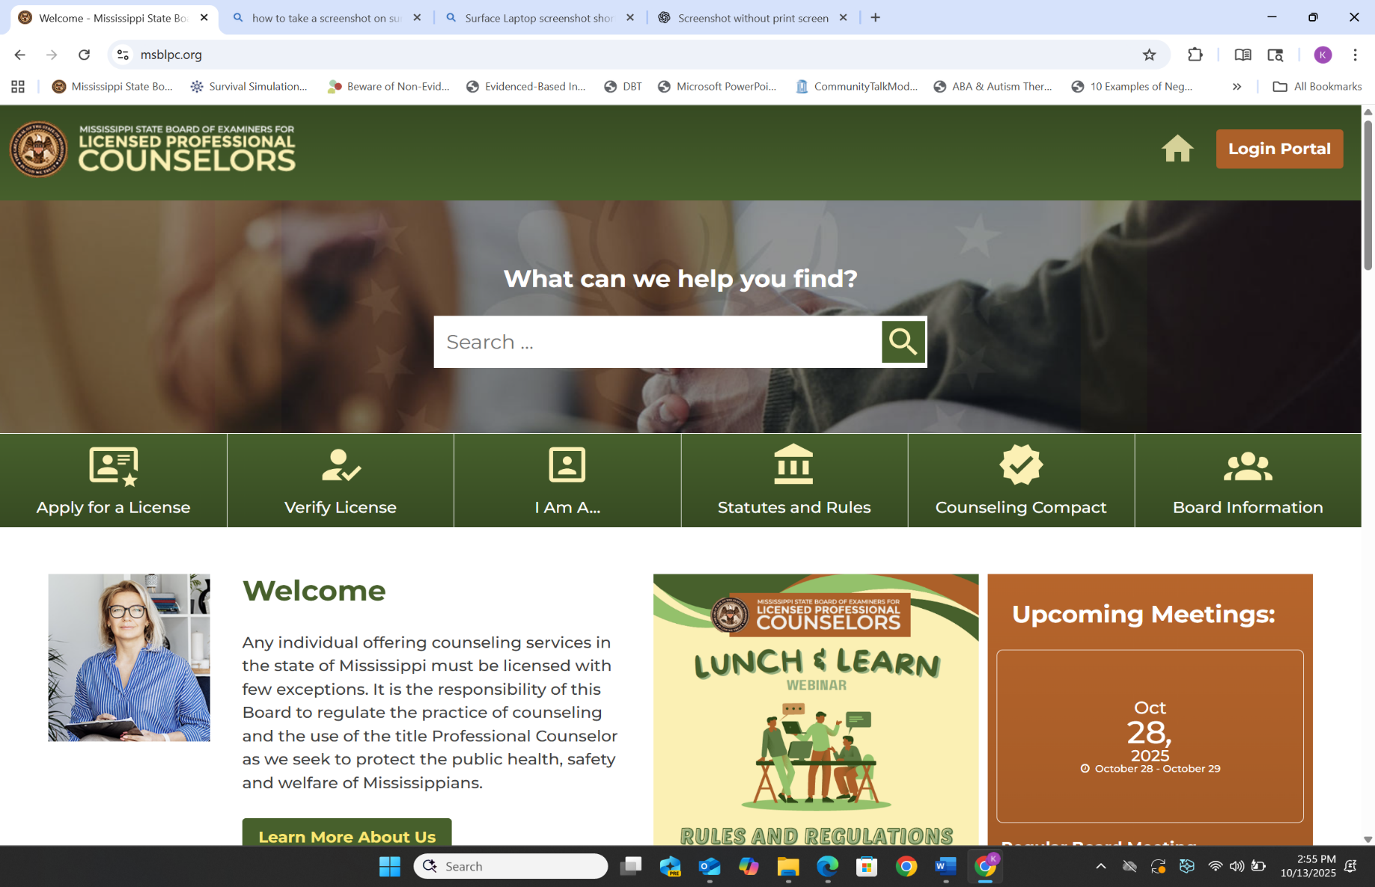

Slide 26
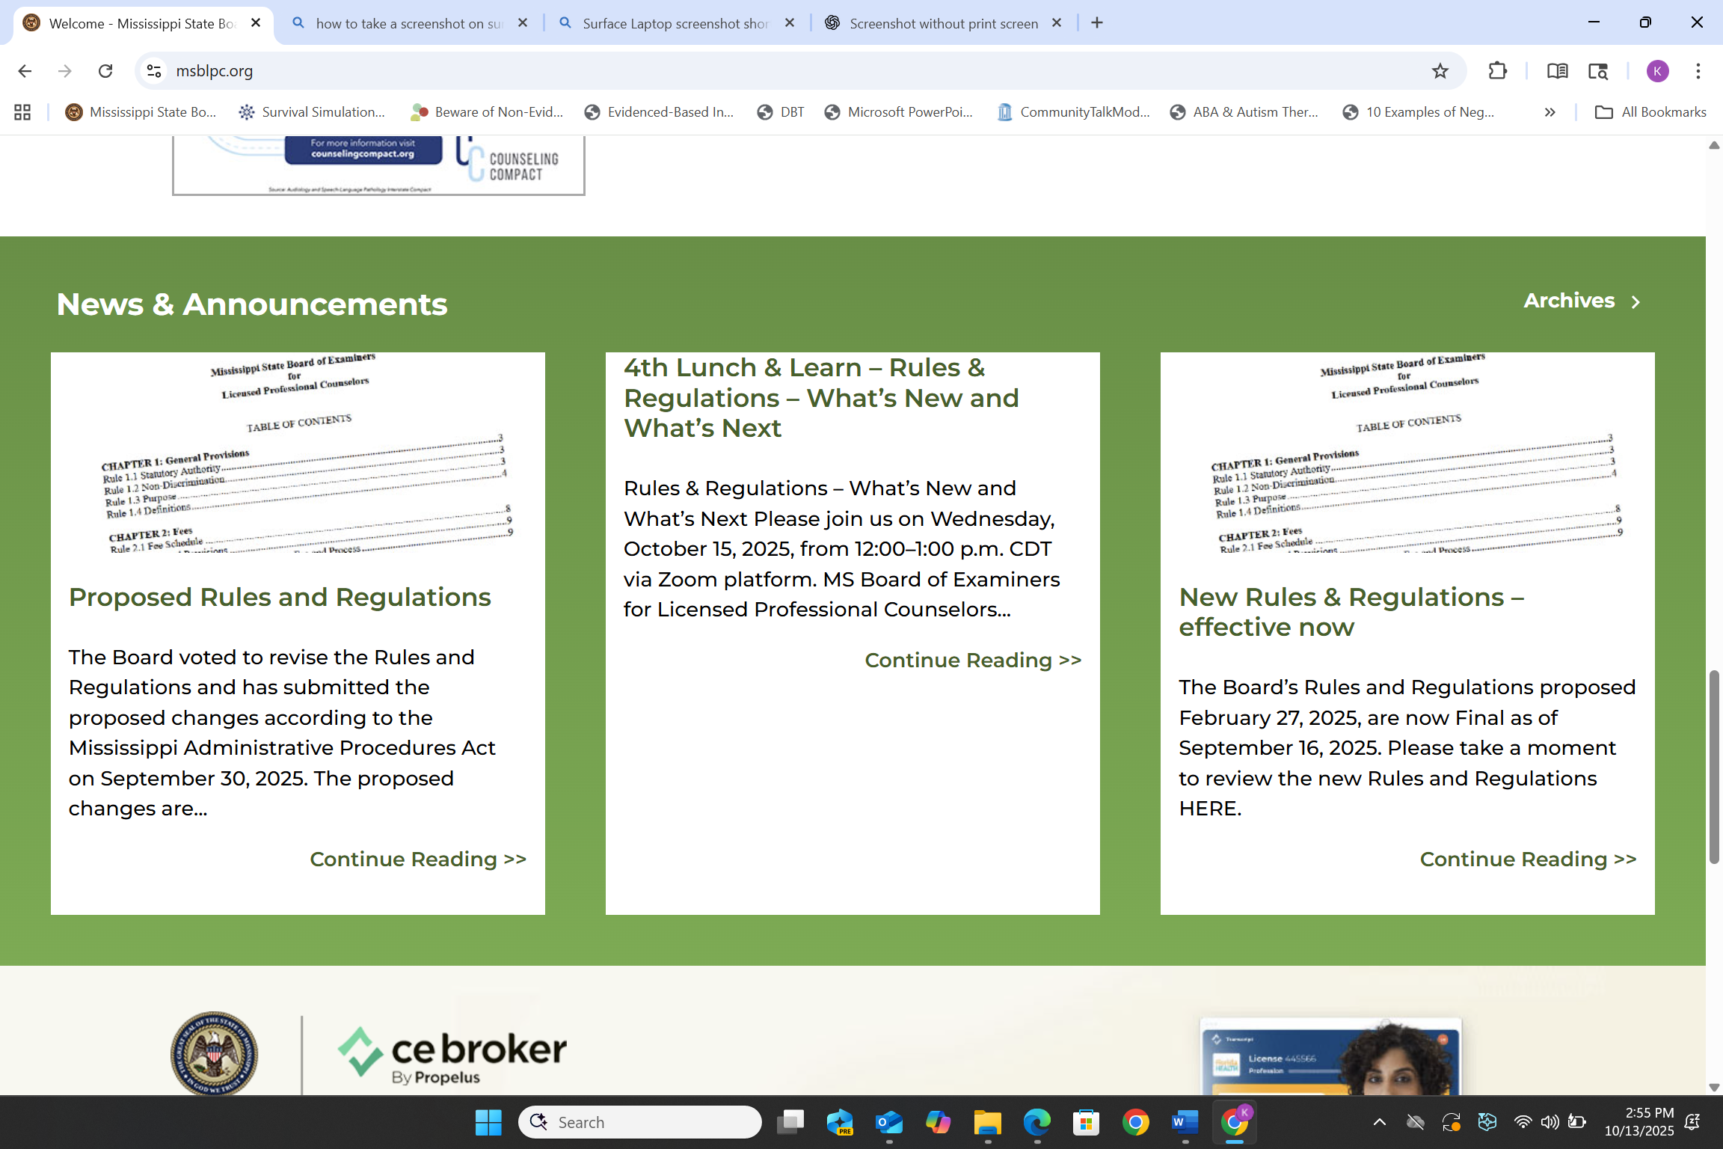

Slide 27
