Slide 1
Supervision Documentation
Hours Log
Notes:
KS/LE
Applicants after July 1, 2018 will not longer be able to count internship and practicum hours

Slide 2
Supervision Reporting Requirements
P-LPCs must report supervised hours using the online log portal provided through the LPC Board’s website
  Supervision Reporting log is in the Supervision Agreement with the LPC-S on the App Info tab in Part III.
Notes:
KS/LE

Slide 3
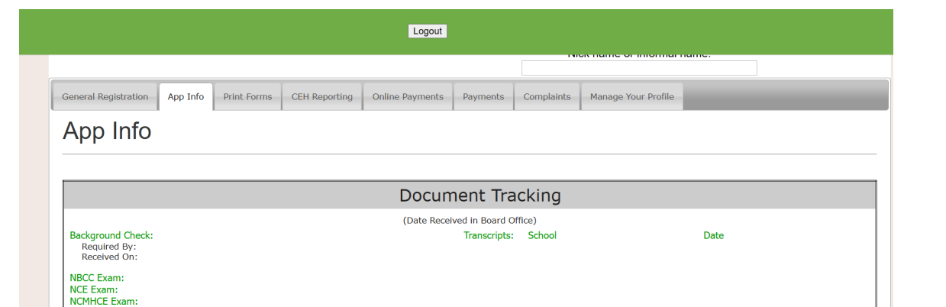
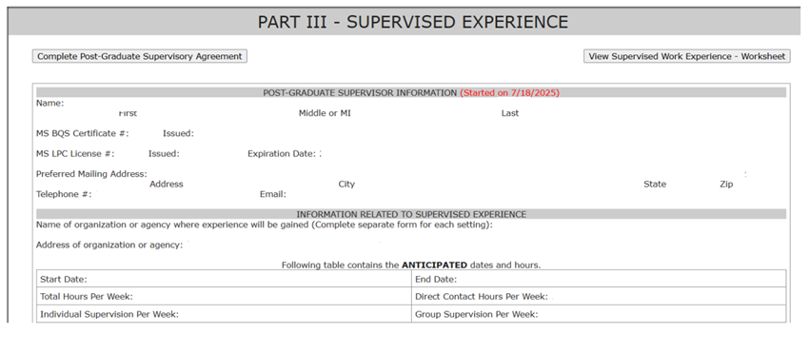
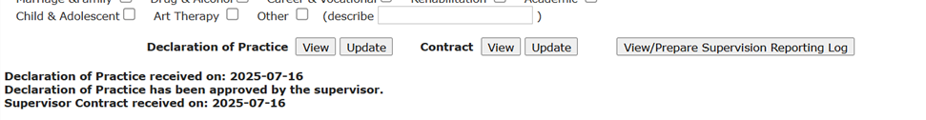
Documenting Supervised Experience

Slide 4
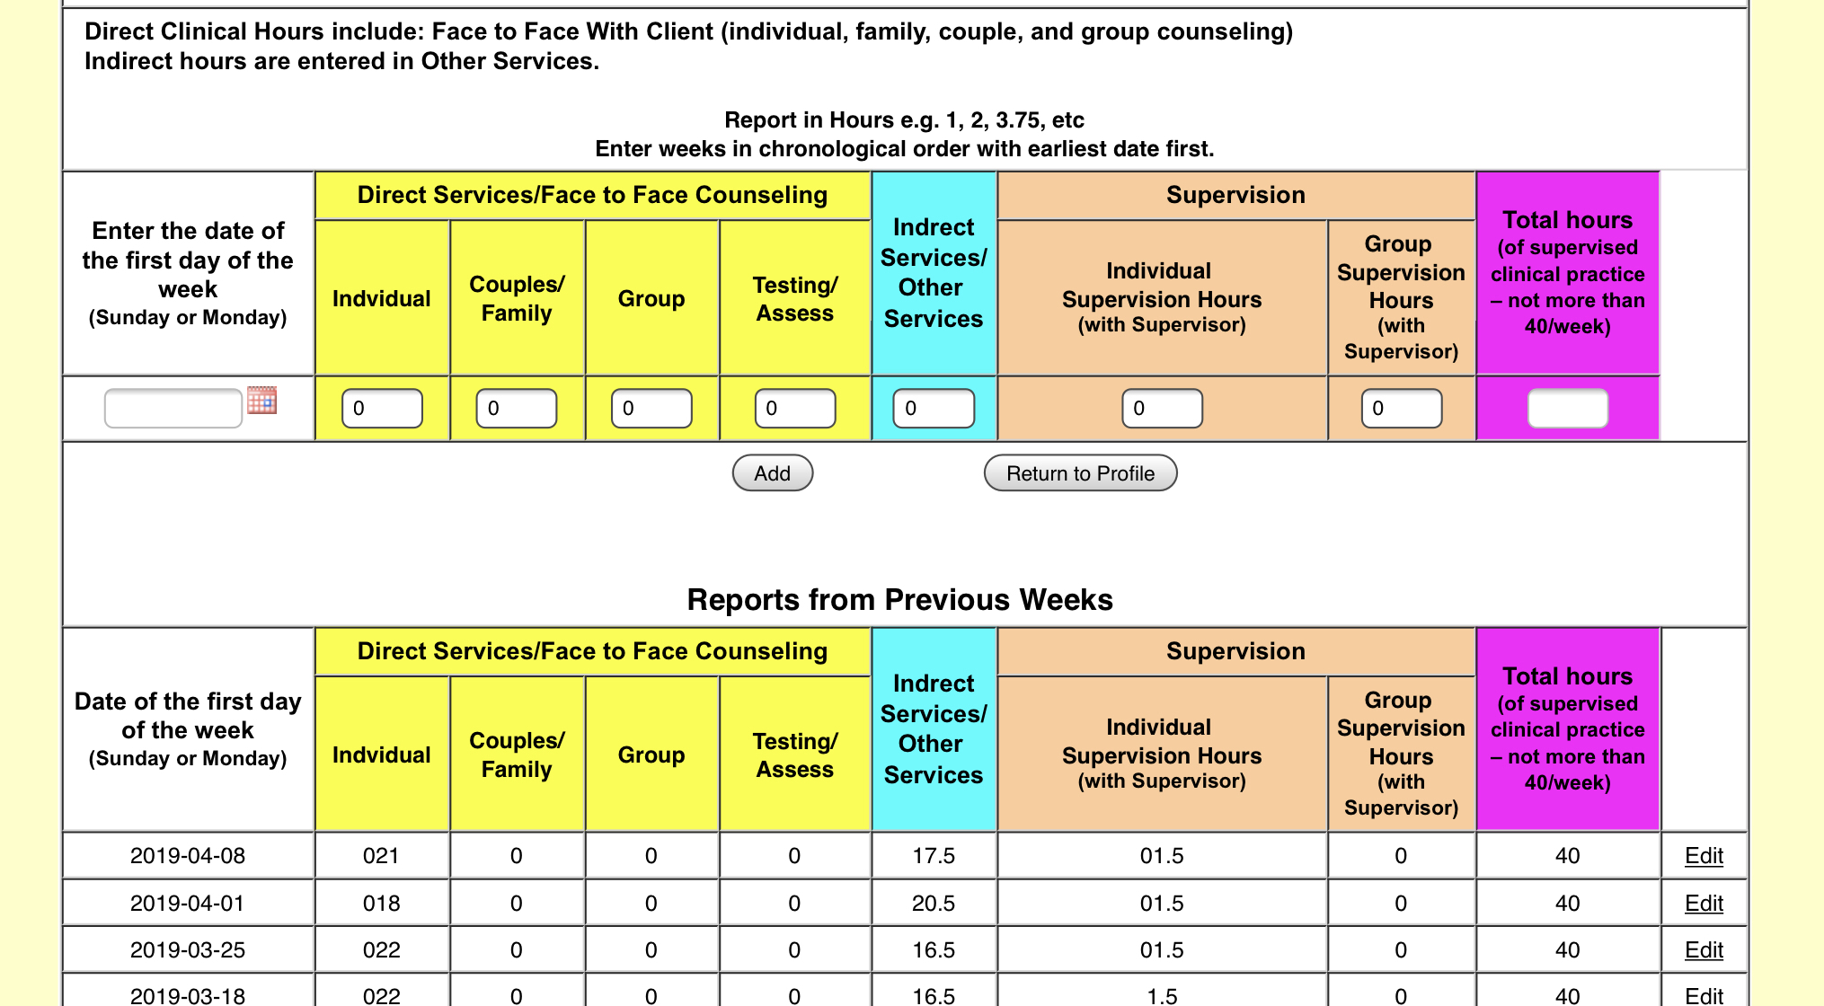
Documenting Supervised Experience

